Slide 1
Deep Learning: From a Logical Neuron to Networks That Learn
AA-5750 Contemporary Issues in Analytics · Week 2 · Chandra Prakash Bathula
Notes:
Week 2. Last week ended at the MLP. This week we tell the whole story in the order it happened: why industry needed deep learning, where the idea came from in 1943, how it nearly died twice, how it came back in 2012, and then the machinery that makes a deep network train: backprop, gradient descent and its variants, activations, initialization, batch norm and regularization. The three notebooks this week (binary, multi-class and regression MLPs) use every one of these knobs.

Slide 2






Today's journey
01
02
03
Why deep learning?
Origins, 1943 to 1969
Winters and revival
Where classical ML hits a wall, industry by industry.
McCulloch and Pitts, Hebb, Turing, the perceptron, ADALINE and XOR.
Two AI winters, backprop in 1986, LeNet, LSTM and the people who persisted.
04
05
06
The rise, 2006 onward
How a network learns
Making it trainable
Data, GPUs and better algorithms meet at ImageNet 2012.
Loss, gradient descent, backprop, SGD and modern optimizers.
Activations, initialization, batch norm and regularization.
Notes:
Six parts, in historical order, then the mechanics. Parts 1 to 4 are the story; Parts 5 and 6 are the toolkit you will use in the notebooks.

Slide 3
Where classical machine learning hits a wall
PART 1 · WHY DEEP LEARNING
And how deep learning changed the answer in industry after industry
Notes:
Before the history, the motivation. Deep learning did not win because it was fashionable. It won on problems where classical methods had plateaued for years.

Slide 4
Classical ML learns from features someone designed
Classical machine learning
Raw data
Hand-crafted features
Classical model
Prediction
pixels, audio, text
SIFT, HOG, MFCC, n-grams, ratios
SVM, random forest, logistic regression
Designed by a human expert
Deep learning
Raw data
layer 1
edges
layer 2
textures
layer 3
parts
layer 4
objects
Prediction
the same pixels, audio, text
Features learned from data, layer by layer
The bottleneck moved. Classical ML is limited by how good the hand-made features are; deep learning by data and compute, which kept getting cheaper.
Notes:
The key shift: in classical ML a human decides what the model sees. In deep learning the network learns the features itself, layer by layer. For faces, early layers learn edges, middle layers learn eyes and noses, later layers learn whole faces. The cost moved from expert time to data and compute.

Slide 5
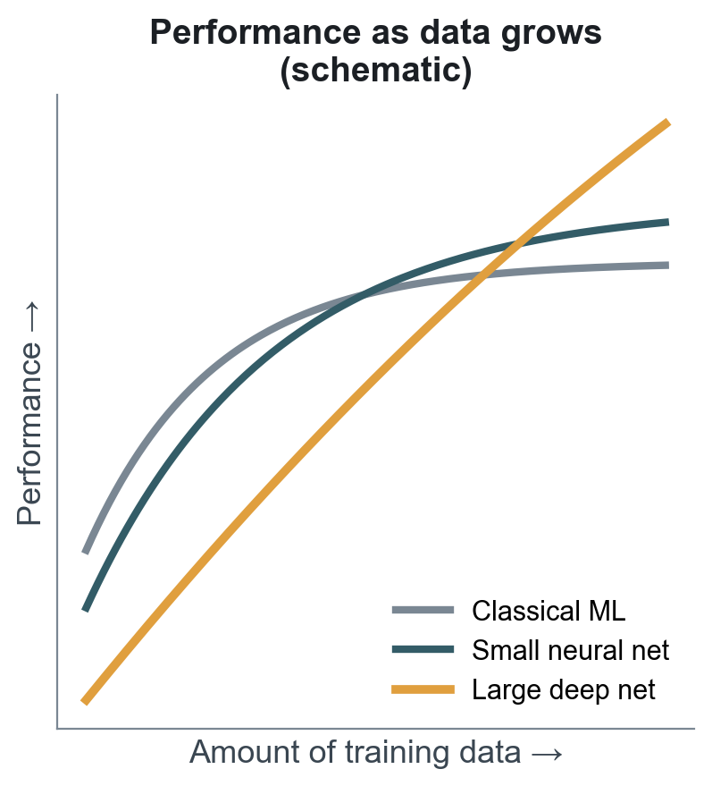




Four walls classical ML runs into
Raw input is huge and unstructured
Features must be engineered by hand
A 224 × 224 colour image is 150,528 numbers. No single pixel means anything; meaning lives in patterns across thousands.
SIFT and HOG for vision, MFCCs for speech, n-grams for text: each took experts years and breaks when conditions change.
More data stops helping
Order and context are ignored
Linear models and trees saturate; kernel SVMs need time and memory that grow with the square of the data or worse.
Bag-of-words treats "not good" like "good". Speech, language and sensor streams need models that read sequences.
Shape only, after Andrew Ng's widely used sketch; not measured results.
Notes:
Andrew Ng's well-known sketch: classical algorithms plateau as data grows, while larger neural networks keep improving. The chart is schematic, not measured data. Each card is one reason why. Kernel SVM training typically scales between quadratic and cubic in the number of examples, which is why SVMs were hard to use on millions of images.

Slide 6



Industry by industry: perception and language
Healthcare imaging
Speech recognition
Translation and text
Classical approach
Expert-designed lesion features fed to SVMs. Fragile across scanners and hospitals; missed subtle patterns.
Classical approach
Gaussian mixture + hidden Markov models over hand-made MFCC features. Error rates barely moved for a decade.
Classical approach
Phrase-based statistical translation with n-gram language models. Lost long-range context and word order.
Deep learning answer
Convolutional networks read raw retinal photos, X-rays and skin images and learn the features themselves.
Deep learning answer
Deep acoustic models (2012), then recurrent and Transformer models trained end to end on audio.
Deep learning answer
Sequence-to-sequence networks with attention, then Transformers (2017) that read the whole sentence.
Landmark Gulshan et al., JAMA 2016: diabetic retinopathy screening at ophthalmologist level (AUC ≈ 0.99).
Landmark Microsoft 2016: 5.9% word error on Switchboard, on par with professional transcribers.
Landmark Google GNMT 2016: about 60% fewer translation errors than its phrase-based system in human ratings.
Notes:
Healthcare: Gulshan et al., JAMA 2016, a deep CNN for referable diabetic retinopathy reached AUC about 0.99 on two validation sets. Esteva et al., Nature 2017, a CNN matched 21 board-certified dermatologists on skin-cancer classification. Speech: Hinton et al., IEEE Signal Processing Magazine 2012, summarises four groups (Toronto, Microsoft, Google, IBM) replacing Gaussian-mixture acoustic models with deep nets. Microsoft reported 5.9% word error on Switchboard in 2016, matching professional transcribers. Translation: Wu et al. 2016 (Google Neural Machine Translation) reported translation errors reduced by about 60% on average versus the phrase-based production system in human side-by-side evaluations.

Slide 7



Industry by industry: decisions, vision and science
Autonomous driving
Retail and recommendations
Science: protein folding
Classical approach
Hand-coded rules plus HOG + SVM pedestrian detectors. Impossible to list every road, light and weather case.
Classical approach
Matrix factorization of a user × item table. Ignores content, context and time; struggles with new items.
Classical approach
Physics-based simulation and templates. Structure from sequence was a 50-year grand challenge.
Deep learning answer
Deep networks for detection, segmentation and tracking on camera and LiDAR, trained on millions of labelled frames.
Deep learning answer
Deep recommenders learn embeddings for users, items, text and images, and combine them with context.
Deep learning answer
AlphaFold 2 learns from known structures, using attention over sequence alignments and residue pairs.
Landmark Deep detectors now underpin perception in driver-assistance and robotaxi systems.
Landmark YouTube (RecSys 2016) and Google Play's Wide & Deep (2016) moved to deep recommenders.
Landmark CASP14, 2020: median accuracy 92.4 GDT. 2024 Nobel Prize in Chemistry.
Notes:
Autonomous driving: classical pedestrian detection used HOG features with linear SVMs (Dalal and Triggs 2005). Modern perception stacks use deep networks on camera and LiDAR. Recommendations: Covington, Adams and Sargin, RecSys 2016, describe YouTube's two-stage deep recommender; Cheng et al. 2016 introduced Wide and Deep for Google Play. Science: AlphaFold 2 at CASP14 (2020) reached a median GDT score of 92.4, close to experimental accuracy; Hassabis and Jumper shared the 2024 Nobel Prize in Chemistry with David Baker.

Slide 8




But not everywhere: when classical ML still wins
Tabular data
Rule of thumb
On spreadsheets of mixed columns, gradient-boosted trees (XGBoost, LightGBM) still often beat deep nets (Grinsztajn et al., NeurIPS 2022).
Data type | Usual first choice
Images, video | Deep learning (CNNs, ViTs)
Audio, speech | Deep learning
Text, documents | Deep learning (Transformers)
Sequences, logs | Deep learning or boosted trees
Tabular, < 100k rows | Boosted trees, then try an MLP
Small datasets
With a few hundred labelled rows, a network has too many weights to fit reliably; simpler models generalize better.
Explanation required
Credit, insurance and hiring decisions may need reasons a regulator can audit. Linear models and small trees explain themselves.
Tight compute budget
On-device or millisecond-latency settings can favour a small linear model over a large network.
Analytics lesson: pick the model for the data. Deep learning wins on raw, high-dimensional, unstructured data at scale.
Notes:
Balance matters. Grinsztajn, Oyallon and Varoquaux, NeurIPS 2022, benchmark 45 tabular datasets and find tree-based models still beat deep nets on typical medium-sized tabular data. For this week's heart-disease notebook, compare the MLP against a gradient-boosted tree before declaring victory.

Slide 9
1943 to 1969: the idea of an artificial neuron
PART 2 · ORIGINS
From logic gates to the first machine that learned its own weights
Notes:
Correcting two common mix-ups: the McCulloch-Pitts neuron is from 1943 (not 1935), and the perceptron is Frank Rosenblatt's (1958), not Alan Turing's. Turing's role was asking whether machines could think and learn at all. Related reading: Deep Learning series Parts 1 to 3.

Slide 10
Eighty years in one picture
Progress
Setback
Revival / breakthrough
1943
McCulloch & Pitts logical neuron
1950
Turing: can machines think?
1958
Rosenblatt's perceptron
1969
Minsky & Papert: XOR
1982
Hopfield networks
1987
Second AI winter
1997
LSTM
1949
Hebb: learning as wiring
1956
Dartmouth names "AI"
1960
Widrow & Hoff ADALINE
1974
First AI winter
1986
Backprop in Nature
1989
CNN reads ZIP codes
1998
LeNet-5 reads cheques
2009
ImageNet; GPUs
2012
AlexNet wins ImageNet
2015
ResNet, batch norm
2017
Transformer
2020
AlphaFold 2
2024
Nobel Prizes for AI
2006
Deep belief nets
2010
ReLU, Xavier init
2014
GANs, Adam
2016
AlphaGo
2018
Turing Award: Hinton, LeCun, Bengio
2022
ChatGPT
Notes:
Read the top lane as the long road from 1943 to the 1990s, with two winters; the bottom lane is the acceleration since 1998. Colour shows mood: teal for progress, red for setbacks, amber for revivals and breakthroughs.

Slide 11
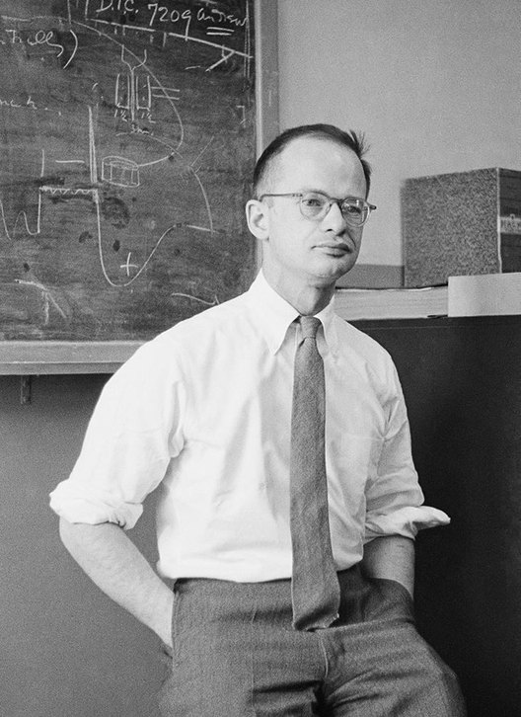
1943: McCulloch and Pitts model the neuron as a logic gate
What it showed
x₁
A neuron can be treated as a logic gate
Networks of them can compute any logical function, like a computer
Influenced von Neumann's computer design and cybernetics
Σ ≥ θ ?
x₂
y ∈ {0, 1}
Binary inputs, fixed threshold θ, all-or-nothing output
What it lacked
No learning: every weight and threshold set by hand
Only 0/1 signals, no degrees of confidence
Walter Pitts, 1954. Photo: Francis Bello, public domain
x₁ | x₂ | AND (θ = 2) | OR (θ = 1)
0 | 0 | 0 | 0
0 | 1 | 0 | 1
1 | 0 | 0 | 1
1 | 1 | 1 | 1
Warren McCulloch (neurophysiologist) and Walter Pitts (logician), "A Logical Calculus of the Ideas Immanent in Nervous Activity", 1943
Notes:
Warren McCulloch, a neurophysiologist, and Walter Pitts, a self-taught logician barely 20, published 'A Logical Calculus of the Ideas Immanent in Nervous Activity' in the Bulletin of Mathematical Biophysics, 1943. Their unit adds binary inputs and fires if the sum reaches a threshold. With threshold 2 and two inputs it is AND; with threshold 1 it is OR; an inhibitory input gives NOT. So networks of these units can compute any logical function. What it did not have: any way to learn.

Slide 12


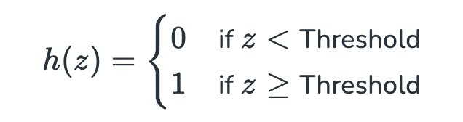


Why the McCulloch–Pitts neuron was not enough
The activation was a hard step
No learning
Binary only
A human had to design every weight and threshold for each task.
Inputs and outputs were 0 or 1. Real signals such as pixel brightness are graded.
Flat almost everywhere, then a jump. A small change in a weight either changes nothing or flips the answer, so there is no direction that says "improve a little".
Equal excitatory inputs
No uncertainty
All active inputs counted the same; one inhibitory input vetoed firing.
No probability, no confidence: just fire or don't.
The missing piece: a rule that adjusts the weights from examples. The next 40 years are a search for one.
Notes:
The step function is the heart of the problem. Its output jumps from 0 to 1, so a small change in a weight either does nothing or flips the output. There is no slope to follow. Everything after 1943 is a search for a neuron that can learn: Hebb gives a learning idea, Rosenblatt a learning rule, Widrow a gradient, and 1986 a way to push gradients through many layers.

Slide 13
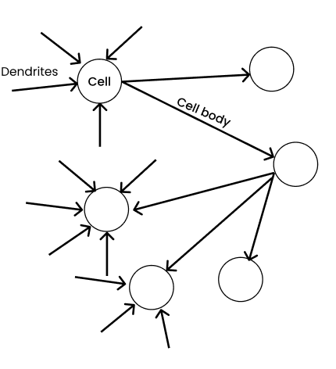
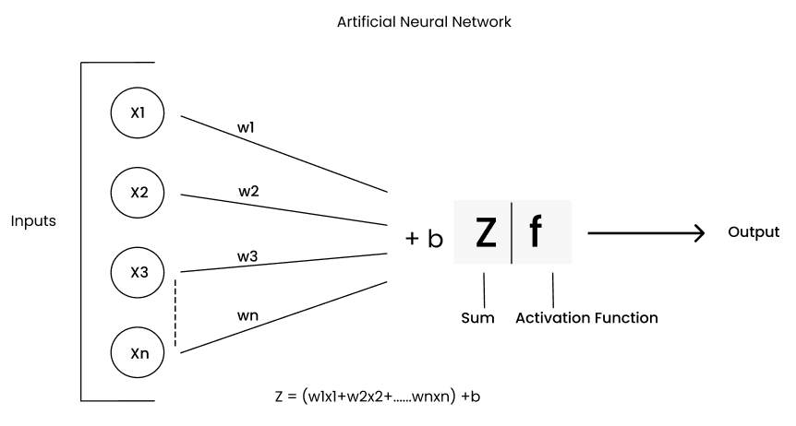
From a biological neuron to an artificial one
Figures: C. P. Bathula, Deep Learning series, Part 2 (Towards AI)
Dendrites
Synapse strength
Cell body
Fires or not
Axon
→ inputs xᵢ
→ weights wᵢ
→ z = Σ wᵢxᵢ + b
→ activation f(z)
→ output to next layer
Notes:
The vocabulary we use all term. Dendrites collect signals, synapses have strengths (weights), the cell body integrates (weighted sum plus bias), and the axon hillock decides whether to fire (activation function). The analogy is loose: real neurons spike in time and are far more complex, but the abstraction stuck.

Slide 14
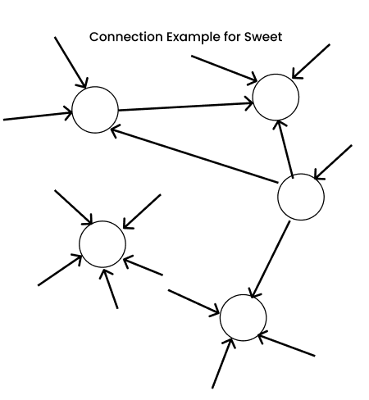
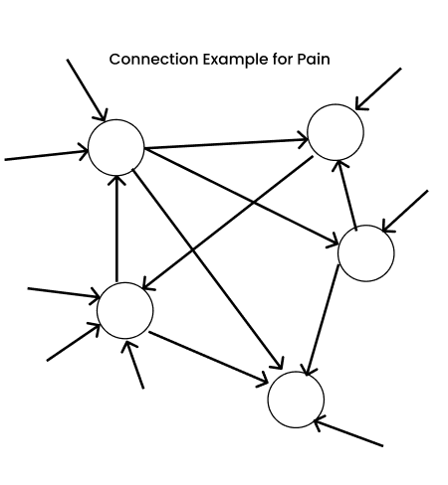
1949: Hebb, learning is a change in connection strength
Donald Hebb, The Organization of Behavior (1949)
"When an axon of cell A is near enough to excite a cell B and repeatedly or persistently takes part in firing it, some growth process or metabolic change takes place in one or both cells such that A's efficiency, as one of the cells firing B, is increased."
Learning = strengthening connections used together
First learning rule: Δw = η · x · y
Tasting something sweet
Touching something hot
Figures: C. P. Bathula, Deep Learning series, Part 2 (Towards AI)
Limitation: Hebb's rule has no notion of error. It strengthens whatever fires together, right or wrong. Rosenblatt adds the error signal in 1958.
Notes:
Donald Hebb, The Organization of Behavior (1949): when one cell repeatedly helps fire another, the connection between them grows stronger. Often summarised as 'cells that fire together wire together'. This is the first concrete idea that learning lives in the weights. The Hebbian update Δw = η·x·y has no error signal, so it can strengthen wrong associations, but it planted the idea that Rosenblatt made error-driven.

Slide 15
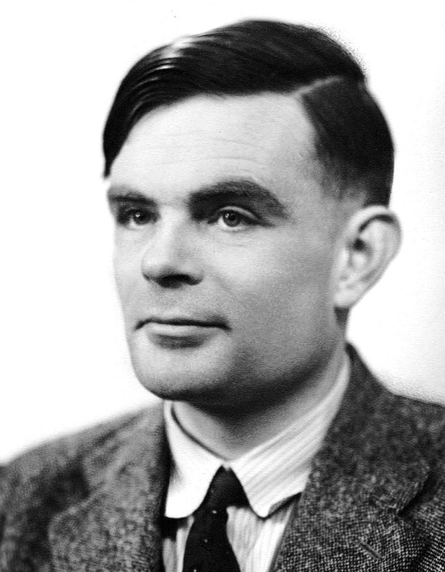
1950: Turing asks whether a machine can learn
1948
"Intelligent Machinery"
Describes "unorganised machines": randomly wired networks of simple units trained by adjusting connections. Unpublished until 1968.
1950
"Computing Machinery and Intelligence"
Asks "Can machines think?", proposes the imitation game, and argues for machines that learn from experience.
1956
Dartmouth workshop
McCarthy, Minsky, Rochester and Shannon coin "artificial intelligence". The field splits: symbolic rules vs learning networks.
Alan Turing. Photo: Elliott & Fry, public domain
"Instead of trying to produce a programme to simulate the adult mind, why not rather try to produce one which simulates the child's?"
Alan Turing, Mind, 1950
Notes:
Turing's 1948 National Physical Laboratory report 'Intelligent Machinery' (published only in 1968) described 'unorganised machines', randomly wired networks of NAND-like units that could be trained by switching connections: an early connectionist idea. His 1950 paper in Mind, 'Computing Machinery and Intelligence', proposed the imitation game (Turing test) and suggested building a child-machine that learns. Turing did not build the perceptron; that was Rosenblatt in 1958. The 1956 Dartmouth Summer Research Project, proposed by McCarthy, Minsky, Rochester and Shannon, coined the term artificial intelligence.

Slide 16
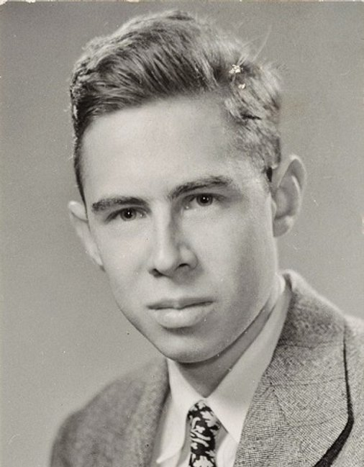
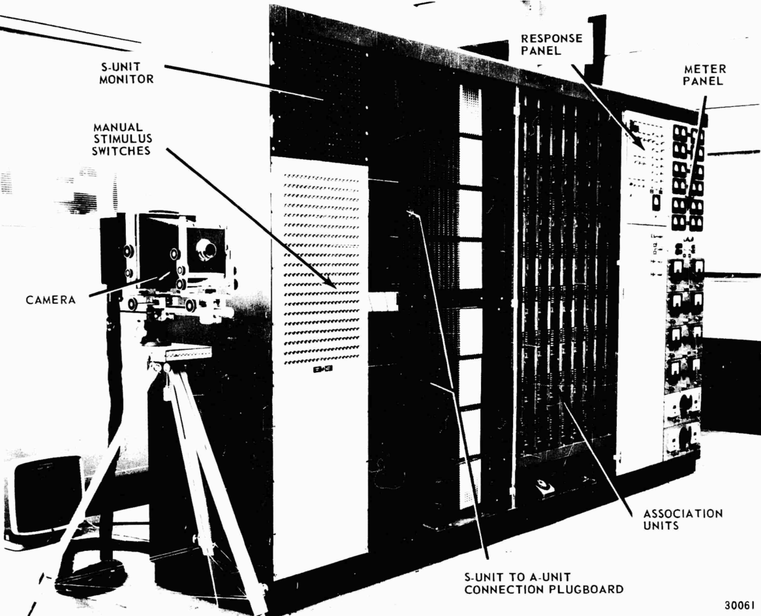
1958: Rosenblatt's perceptron learns its own weights
The learning rule
ŷ = step(w · x + b)
w ← w + η (y − ŷ) x
Right answer: y − ŷ = 0, no change
Wrong answer: weights move toward the correct class
Converges if a straight line can separate the classes (Novikoff, 1962)
Frank Rosenblatt. CC BY-SA 4.0
Mark I Perceptron operator's manual (1960), public domain
400
photocells in a 20 × 20 "retina"; weights were motor-driven potentiometers.
New York Times, 8 July 1958: "the embryo of an electronic computer that [the Navy] expects will be able to walk, talk, see, write, reproduce itself and be conscious of its existence."
Notes:
Frank Rosenblatt, a psychologist at the Cornell Aeronautical Laboratory, described the perceptron in a 1957 report and in Psychological Review in 1958. The Mark I Perceptron hardware, funded by the US Office of Naval Research, used a 20 by 20 grid of 400 photocells as its retina; its weights were potentiometers turned by electric motors. The rule: if the prediction is right, do nothing; if wrong, move the weights toward the correct answer. Novikoff (1962) proved it converges in a finite number of updates if the classes are linearly separable. The New York Times, 8 July 1958, called it 'the embryo of an electronic computer that [the Navy] expects will be able to walk, talk, see, write, reproduce itself and be conscious of its existence.'

Slide 17
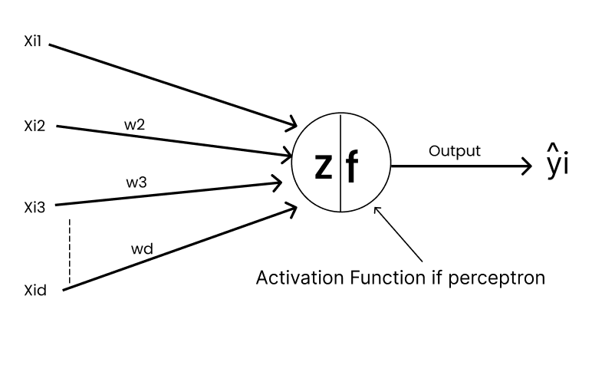
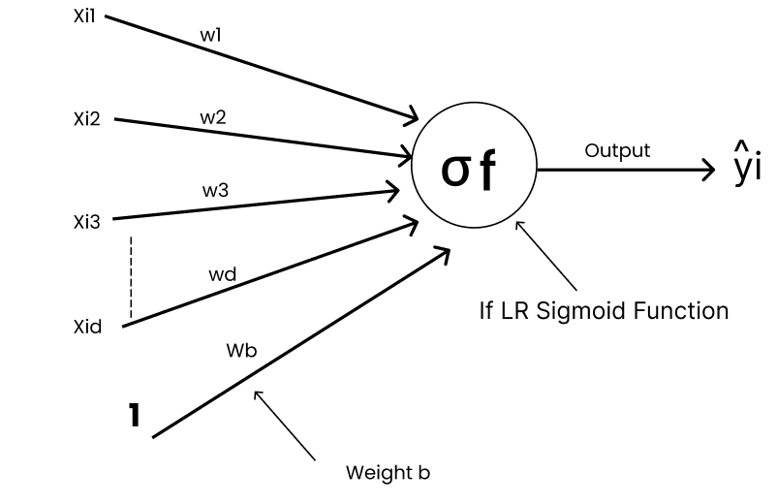
Perceptron vs logistic regression: same score, different last step
Perceptron
a switch: 0 or 1
Logistic regression
a dimmer: probability
Figures: C. P. Bathula, Deep Learning series, Part 3 (Towards AI)
 | Perceptron (1958) | Logistic regression
Score | z = w·x + b | z = w·x + b (identical)
Output | step(z): 1 if z ≥ 0, else 0 | σ(z) = 1 / (1 + e⁻ᶻ), between 0 and 1
Update | w ← w + η (y − ŷ) x, only when wrong | w ← w + η (y − σ(z)) x, every example
Converges | Only if classes are linearly separable | Convex loss: settles even when classes overlap
Notes:
Both compute z = w·x + b. The perceptron passes z through a hard step and outputs a class; logistic regression passes it through a sigmoid and outputs a probability. That one change, a smooth activation, is what later makes gradient-based training possible. Both draw a single straight line, so neither can solve XOR.

Slide 18
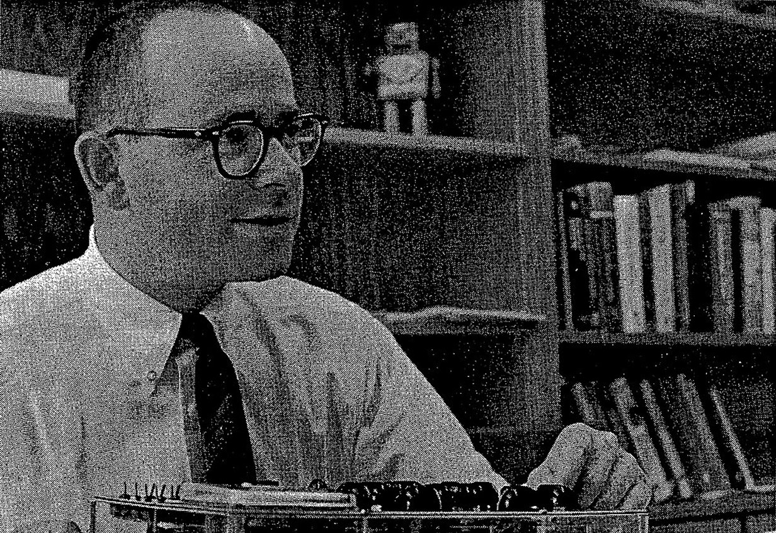



1960: ADALINE learns from the size of the error
Perceptron vs ADALINE
Perceptron: w ← w + η (y − step(z)) x
ADALINE (LMS): w ← w + η (y − z) x
ADALINE learns from how far off z is, not just whether the class was wrong.
Smooth error
Gradient descent
Used in the field
The squared error (y − z)² is a bowl in weight space.
LMS steps downhill on that bowl: the ancestor of every optimizer.
MADALINE filters cancelled echoes on phone lines.
Bernard Widrow with ADALINE. Stanford Today, 1963, public domain
Why it matters: measuring error on a smooth quantity gives a slope to follow. Backpropagation (1986) extends this idea through hidden layers.
Notes:
Bernard Widrow and his student Ted Hoff (who later co-designed Intel's first microprocessor) built ADALINE at Stanford in 1960. The key difference from the perceptron: the error is measured on the linear output before thresholding, so the squared error is a smooth function of the weights and the Least Mean Squares rule is gradient descent on it. MADALINE, a layered version, was used for adaptive filters that cancel echoes on telephone lines, one of the first real-world neural network applications.

Slide 19
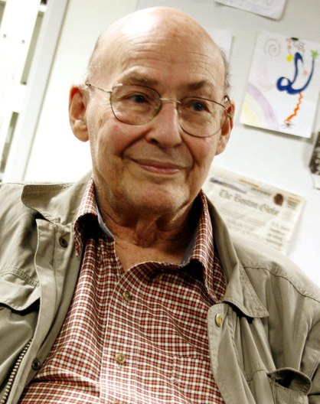
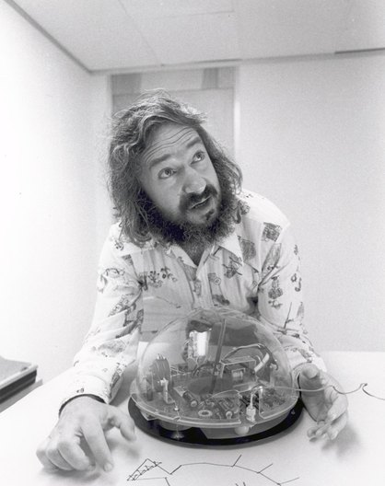
1969: Minsky and Papert show what one layer cannot do
XOR: no single line works
✕
XOR and parity
x₂
No straight line separates the classes.
(0,1)
(1,1)
✕
Connectedness
Units that see only local patches cannot tell if a shape is connected.
Minsky (Sethwoodworth, CC BY 3.0); Papert (CC BY-SA 3.0)
Perceptrons: An Introduction to Computational Geometry (MIT Press, 1969)
✕
Hidden layers untrainable
(0,0)
(1,0)
Multi-layer nets could solve these, but nobody knew how to train them.
x₁
● output 1 ○ output 0
Effect: read as "neural networks are a dead end". Funding and talent moved to symbolic, rule-based AI.
Notes:
Perceptrons (1969) by Marvin Minsky and Seymour Papert gave rigorous proofs of what single-layer perceptrons cannot compute: XOR, parity, and connectedness when units see only local patches. Multi-layer networks could represent these functions, but there was no known way to train the hidden layers. The book was widely read as a verdict on neural networks in general and coincided with funding moving to symbolic AI.

Slide 20
1970 to 2006: two winters, one breakthrough
PART 3 · WINTERS AND REVIVAL
Backpropagation, convolutional networks and LSTMs grew while funding was scarce
Notes:
Note on dates: 1986 is not an AI winter; it is the year backpropagation was popularised. The first AI winter is roughly 1974 to 1980, the second roughly 1987 to the early 1990s. Related reading: Deep Learning series Parts 1 and 4.

Slide 21
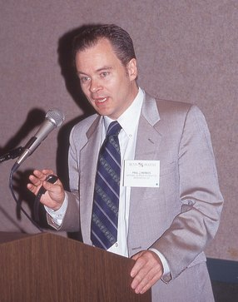
1974 to 1980: the first AI winter
The book
Seeds planted in the cold
Perceptrons (1969) was read as a verdict on all neural networks.
1970 Seppo Linnainmaa: reverse-mode automatic differentiation, the maths of backprop.
The reports
≈ 6 years
UK Lighthill Report (1973) criticised AI's unmet promises; most UK AI funding was cut.
The money
of sharply reduced neural network and AI funding, roughly 1974 to 1980
US Mansfield Amendment and DARPA cuts (≈1974) ended open-ended AI grants.
1974 Paul Werbos's Harvard PhD thesis: use it to train multi-layer networks. Almost nobody noticed for a decade.
The people
Rosenblatt died in 1971. Network research survived in a handful of labs.
Paul Werbos, 1991. Photo: Rolf Kickuth, CC BY-SA 4.0
The lesson: overpromising plus a real limitation plus a famous proof can freeze a field for years. Compare today's AI claims.
Notes:
Several pressures combined. Minsky and Papert's book made single-layer nets look like a dead end. In the UK, the Lighthill Report (1973) criticised AI's failure to deliver and led to deep cuts. In the US, the Mansfield Amendment pushed military research funding toward direct mission needs and DARPA cut speculative AI work around 1974. Rosenblatt died in a boating accident in 1971. Yet the key algorithm was quietly invented: Seppo Linnainmaa's 1970 master's thesis described reverse-mode automatic differentiation, and Paul Werbos's 1974 Harvard PhD thesis proposed using it to train neural networks.

Slide 22
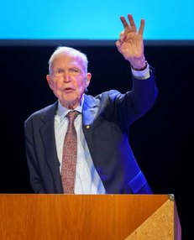


1980 to 1985: new architectures in the quiet years
1980
1982
1985
Kunihiko Fukushima
John Hopfield
Ackley, Hinton & Sejnowski
Neocognitron
Hopfield network
Boltzmann machine
Layers of feature detectors with shift tolerance, modelled on the visual cortex. The blueprint for CNNs.
Memories stored as low-energy states of a recurrent network. Brought physicists and new maths into the field.
Stochastic units and a learning rule for hidden units. Its restricted form returns in 2006.
Photo: Jay Dixit, CC BY-SA 4.0
2024: Hopfield and Hinton received the Nobel Prize in Physics for foundational discoveries that enable machine learning with artificial neural networks.
Notes:
Kunihiko Fukushima's Neocognitron (1980) stacked layers of simple and complex cells, inspired by Hubel and Wiesel's work on the visual cortex. It is the direct ancestor of convolutional networks, but it was trained without backprop. John Hopfield's 1982 PNAS paper showed that a recurrent network can store memories as minima of an energy function, which brought physicists into the field. Ackley, Hinton and Sejnowski's Boltzmann machine (1985) added stochastic units and a learning rule for hidden units. Hopfield and Hinton shared the 2024 Nobel Prize in Physics for these foundations.

Slide 23
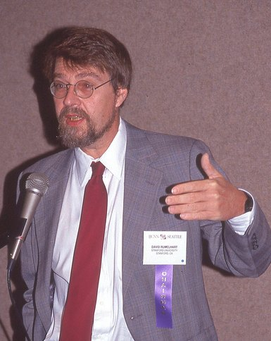
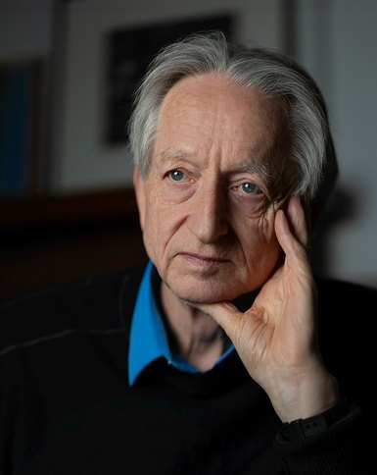
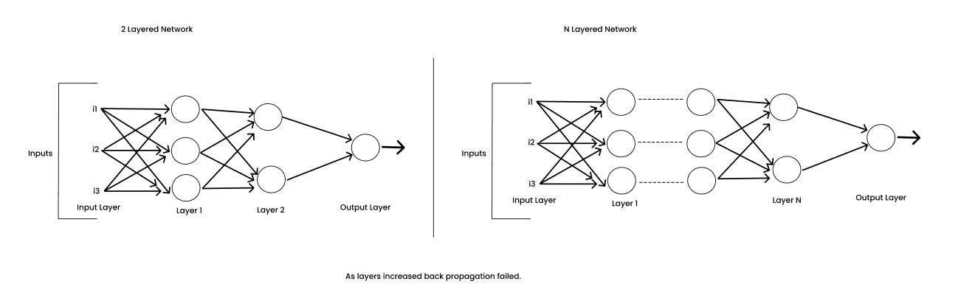



1986: backpropagation makes hidden layers trainable
David Rumelhart
Rolf Kickuth, CC BY-SA 4.0
Geoffrey Hinton
Cmichel67, CC BY-SA 4.0
Figure: C. P. Bathula, Deep Learning series, Part 4 (Towards AI)
with Ronald J. Williams. "Learning representations by back-propagating errors", Nature 323, 533–536 (1986)
Smooth activation
Errors flow backward
Hidden layers learn
Swap the step for a sigmoid so every unit has a slope.
The chain rule passes the output error back through each layer.
Hidden units discover their own features; XOR becomes easy.
The revival: 1986 is not a winter. It is the year the field learned to train hidden layers, 28 years after the perceptron.
Notes:
Rumelhart, Hinton and Williams, 'Learning representations by back-propagating errors', Nature 323, 1986, together with the two-volume Parallel Distributed Processing books, showed that the chain rule can assign blame to every weight, including hidden ones, as long as the activation is smooth (they used the sigmoid). Hidden units learned useful internal representations nobody programmed. Backprop itself had earlier roots (Linnainmaa 1970, Werbos 1974), but 1986 is when the field adopted it.

Slide 24

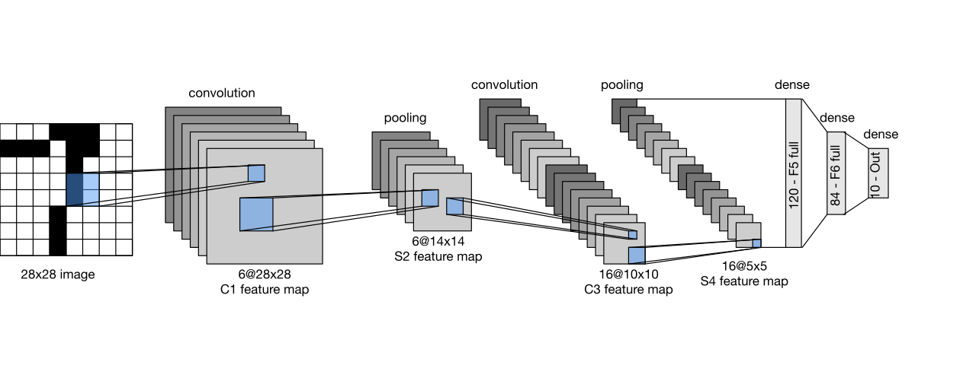
1989 to 1998: neural networks get practical
Jérémy Barande, CC BY-SA 2.0
LeNet-5. Zhang, Lipton, Li & Smola, Dive into Deep Learning, CC BY-SA 4.0
1989
1989
1998
CNN reads ZIP codes
Universal approximation
LeNet-5 in production
LeCun et al. at Bell Labs train a convolutional net with backprop on handwritten digits.
Cybenko; Hornik et al.: one hidden layer can approximate any continuous function, given enough units.
Convolution + pooling + dense layers. A cheque reader built on it handled a large share of US cheques.
Notes:
Yann LeCun and colleagues at Bell Labs trained a convolutional network with backprop to read handwritten ZIP codes (Neural Computation, 1989). LeNet-5 (LeCun, Bottou, Bengio and Haffner, Proceedings of the IEEE, 1998) combined convolution, subsampling and fully connected layers; a cheque-reading system built on it processed a large share of US cheques by the late 1990s. On the theory side, Cybenko (1989) and Hornik, Stinchcombe and White (1989) proved that a network with one hidden layer can approximate any continuous function given enough units: the universal approximation theorem. It says such a network exists, not that training will find it.

Slide 25

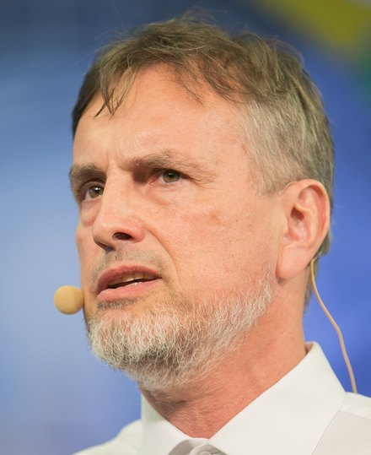
Late 1980s to 2000s: the second winter and the vanishing gradient
1987
Expert-system bust
The Lisp-machine and expert-system market collapses; AI funding dries up again.
1991
Vanishing gradient
Hochreiter shows error signals shrink exponentially as they pass back through many layers.
Sepp Hochreiter
C.Stadler/Bwag, CC BY-SA 4.0
Jürgen Schmidhuber
ITU/R.Farrell, CC BY 2.0
1995
SVMs take the lead
Cortes & Vapnik's support vector machines: convex, well understood, strong on small data.
Why depth failed
A sigmoid's slope is at most 0.25. Ten layers back, the gradient can be 0.25¹⁰ ≈ 10⁻⁶ of its size, so early layers stop learning.
1997
LSTM
Hochreiter & Schmidhuber add gated memory cells so gradients survive long sequences.
Notes:
The second AI winter began around 1987 when the market for Lisp machines and expert systems collapsed. For neural networks the 1990s were a slump of a different kind. Support vector machines (Cortes and Vapnik, 1995) offered a convex problem with a unique solution and strong theory, and often won on the small datasets of the day. Deep networks were hard to train: Sepp Hochreiter's 1991 diploma thesis analysed the vanishing gradient, and Bengio, Simard and Frasconi (1994) showed long-range dependencies are hard to learn with gradient descent. Hochreiter and Schmidhuber's LSTM (1997) added gated memory cells so gradients can flow across long sequences.

Slide 26
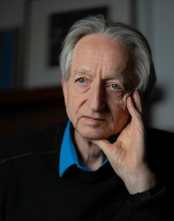

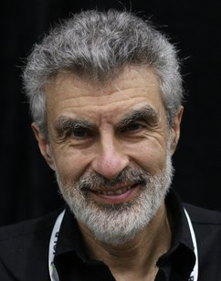
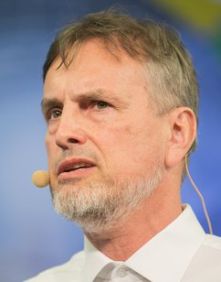
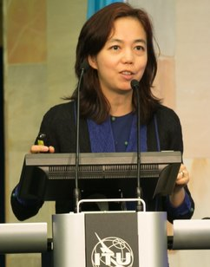
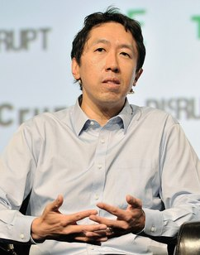
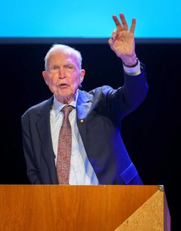

The people who kept the faith
Geoffrey Hinton
Yann LeCun
Yoshua Bengio
Jürgen Schmidhuber
Cmichel67, CC BY-SA 4.0
Jérémy Barande, CC BY-SA 2.0
Xuthoria, CC BY-SA 4.0
ITU/R.Farrell, CC BY 2.0
Backprop (1986), Boltzmann machines, deep belief nets, AlexNet. Turing Award 2018, Nobel 2024.
Convolutional networks and LeNet. Turing Award 2018.
Vanishing gradients, neural language models, attention. Turing Award 2018.
LSTM with Hochreiter (1997); early deep learning research.
Fei-Fei Li
Andrew Ng
John Hopfield
Demis Hassabis
ITU Pictures, CC BY 2.0
TechCrunch, CC BY 2.0
Jay Dixit, CC BY-SA 4.0
John Sears, CC BY-SA 4.0
Created ImageNet (2009) and its annual challenge.
GPU training (2009), Google Brain, and mass online teaching.
Hopfield networks (1982). Nobel Prize in Physics 2024.
DeepMind: AlphaGo, AlphaFold. Nobel Prize in Chemistry 2024.
Notes:
Hinton, LeCun and Bengio received the 2018 ACM A.M. Turing Award for conceptual and engineering breakthroughs that made deep neural networks a critical part of computing. Schmidhuber and Hochreiter gave us LSTM. Fei-Fei Li built ImageNet. Andrew Ng pushed GPU training and large-scale deep learning at Stanford and Google Brain and taught millions online. Hopfield and Hinton shared the 2024 Nobel Prize in Physics; Demis Hassabis and John Jumper of DeepMind shared the 2024 Chemistry prize with David Baker.

Slide 27
2006 to today: deep learning takes over
PART 4 · THE RISE
Better algorithms, much more data and GPUs meet at ImageNet 2012
Notes:
The comeback needed three things at once. Related reading: Deep Learning series Part 1.

Slide 28


2006 to 2010: three ingredients come together
Algorithms
Data
Compute
2006: deep belief nets, trained one layer at a time (Hinton, Osindero & Teh)
2010: Xavier initialization (Glorot & Bengio)
2010–11: ReLU activations train deep nets faster
2012: dropout regularization
2009: ImageNet, 14 million labelled images
The web, smartphones and cheap sensors produce data at scale
Crowdsourced labelling makes large labelled sets affordable
2007: NVIDIA CUDA makes GPUs programmable
2009: GPUs up to 70× faster for training (Raina, Madhavan & Ng)
Thousands of cores built for graphics suit matrix maths
None was enough alone. Backprop existed since 1986. What changed was far more data and compute, plus a few tricks that let gradients reach deep layers.
Notes:
Algorithms: Hinton, Osindero and Teh (2006) showed deep belief nets could be trained greedily, one layer at a time, then fine-tuned; Hinton and Salakhutdinov's Science paper the same year popularised deep learning. Nair and Hinton (2010) and Glorot, Bordes and Bengio (2011) showed ReLUs train deep nets better; Glorot and Bengio (2010) gave principled initialization. Data: ImageNet (Deng et al., CVPR 2009). Compute: NVIDIA released CUDA in 2007, and Raina, Madhavan and Ng (ICML 2009) reported GPUs up to 70 times faster than CPUs for training deep belief nets.

Slide 29
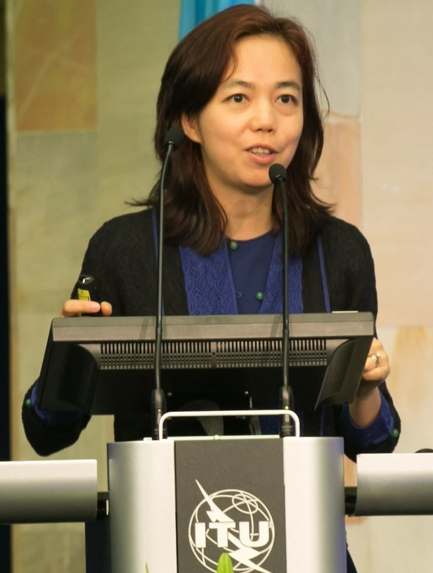
ImageNet: the dataset that changed the benchmark
14M+
≈ 22,000
1.2M
labelled images in the full dataset
categories, organised by WordNet
training images in the 1,000-class challenge (ILSVRC)
How it was built
Images were collected from search engines for each WordNet noun, then verified by tens of thousands of crowd workers on Amazon Mechanical Turk. Deng, Dong, Socher, Li, Li & Fei-Fei, CVPR 2009.
Fei-Fei Li, 2017. ITU Pictures, CC BY 2.0
Why it mattered: every lab could now compare methods on the same large, hard, public test. The yearly ILSVRC results (2010–2017) became the scoreboard for computer vision.
Notes:
Fei-Fei Li started ImageNet at Princeton and continued it at Stanford, organised by the WordNet hierarchy. Deng et al. presented it at CVPR 2009. Images were labelled through Amazon Mechanical Turk by tens of thousands of workers. The ImageNet Large Scale Visual Recognition Challenge ran from 2010 to 2017 on a 1,000-class subset with about 1.2 million training images. Its importance was cultural as much as technical: a big, shared, hard benchmark where any method could be compared fairly.

Slide 30
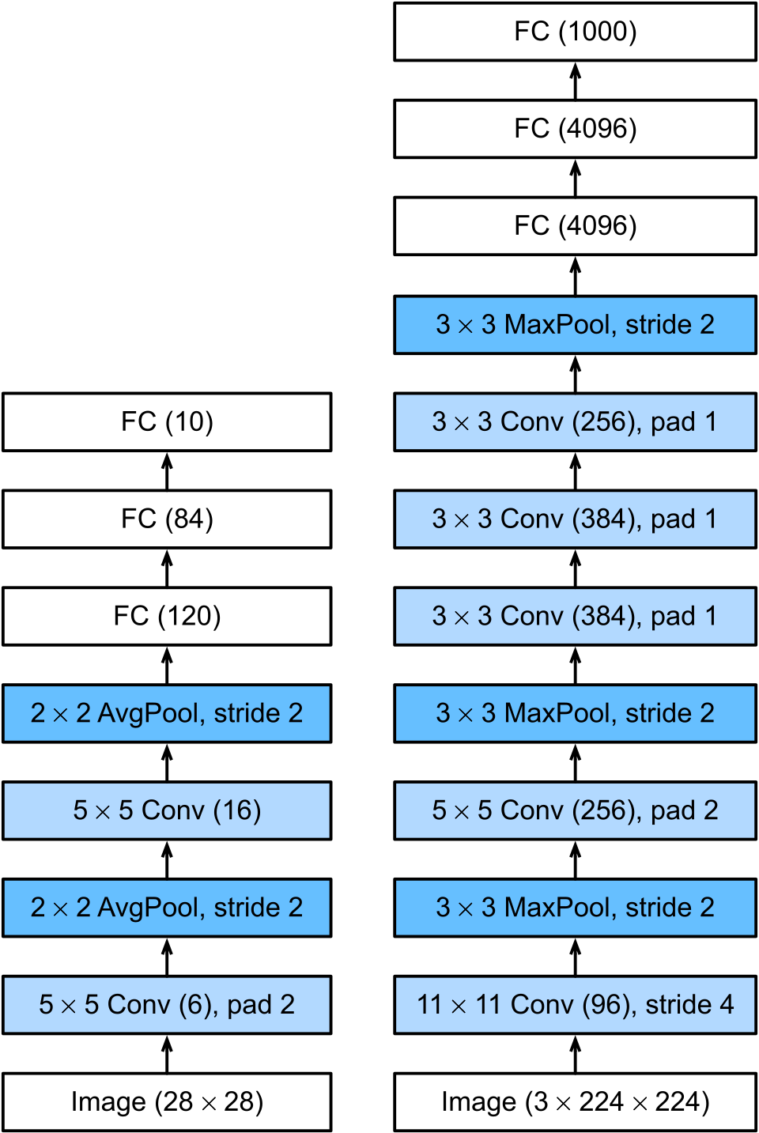


2012: AlexNet nearly halves the error
15.3%
Krizhevsky, Sutskever & Hinton
"ImageNet Classification with Deep Convolutional Neural Networks", NeurIPS 2012, University of Toronto
AlexNet top-5 error, ILSVRC 2012
vs 26.2% for the runner-up using hand-crafted features
60M parameters · 650k neurons · 8 learned layers
ReLU
Dropout
Several times faster training than tanh in their tests
p = 0.5 in the dense layers to curb overfitting
Augmentation
Two GPUs
Random crops, flips and colour shifts (Week 1!)
GTX 580s with 3 GB each, 5–6 days of training
Zhang et al., Dive into Deep Learning, CC BY-SA 4.0
Notes:
Alex Krizhevsky, Ilya Sutskever and Geoffrey Hinton (University of Toronto) entered a deep CNN called SuperVision, now known as AlexNet. It reached 15.3% top-5 test error against 26.2% for the second-best entry, which used classical features. The network had about 60 million parameters and 650,000 neurons in five convolutional and three fully connected layers, and trained for five to six days on two NVIDIA GTX 580 GPUs with 3 GB each. Every trick from this course appears: ReLU, dropout, data augmentation, mini-batch SGD with momentum and weight decay.

Slide 31
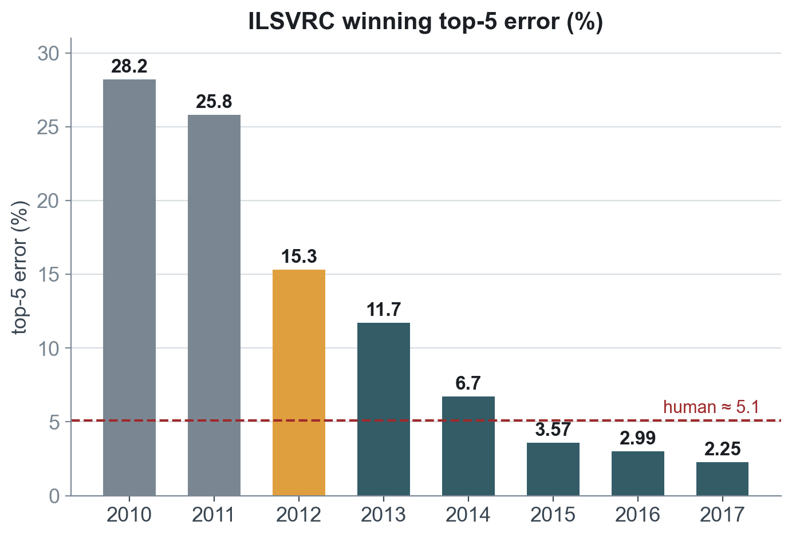
After 2012, the error kept falling
2012
AlexNet
8 layers, ReLU, dropout, GPUs
2014
GoogLeNet / VGG
22 and 19 layers: deeper and narrower
2015
ResNet
152 layers with skip connections; below the ≈5.1% human estimate
2017
SENet
2.25%: the challenge ends, the task considered solved
Grey: classical features. Amber: AlexNet. Teal: deep networks. 2015–2017 rounded.
Notes:
ILSVRC classification winners, top-5 error on the test set: 2010 NEC-UIUC 28.2%; 2011 XRCE 25.8%; 2012 AlexNet 15.3%; 2013 Clarifai 11.7%; 2014 GoogLeNet 6.7%; 2015 ResNet 3.57%; 2016 Trimps-Soushen 2.99%; 2017 SENet 2.25%. Andrej Karpathy measured his own top-5 error at about 5.1% on a sample, a commonly cited human reference. ResNet's skip connections and batch normalization let networks grow to 152 layers.

Slide 32
The deep learning decade and beyond
2013
word2vec
Words as learned vectors
2015
ResNet · BatchNorm
152 layers become trainable
2017
Transformer
"Attention Is All You Need"
2020
AlphaFold 2 · GPT-3
Protein structure; 175B parameters
2024
Nobel Prizes
Physics and Chemistry for AI work
2014
GANs · Adam
Generative models; the default optimizer
2016
AlphaGo
Beats Lee Sedol 4–1 at Go
2018
BERT · Turing Award
Hinton, LeCun, Bengio honoured
2022
ChatGPT
Deep learning reaches the public
Notes:
2013 word2vec (Mikolov et al.). 2014 generative adversarial networks (Goodfellow et al.), sequence-to-sequence learning, and the Adam optimizer (Kingma and Ba). 2015 ResNet (He et al.) and batch normalization (Ioffe and Szegedy). 2016 AlphaGo beat Lee Sedol 4 to 1. 2017 'Attention Is All You Need' introduced the Transformer. 2018 BERT, and the Turing Award to Hinton, LeCun and Bengio. 2020 AlphaFold 2 and GPT-3. 2022 ChatGPT. 2024 Nobel Prizes in Physics (Hopfield, Hinton) and Chemistry (Baker, Hassabis, Jumper).

Slide 33
Loss, gradients and backpropagation
PART 5 · HOW A NETWORK LEARNS
Plus gradient descent, SGD, mini-batches and modern optimizers
Notes:
Now the mechanics. Everything here appears in this week's three notebooks: criterion, loss.backward(), optimizer.step(). Related reading: Deep Learning series Parts 4, 5 and 9.

Slide 34
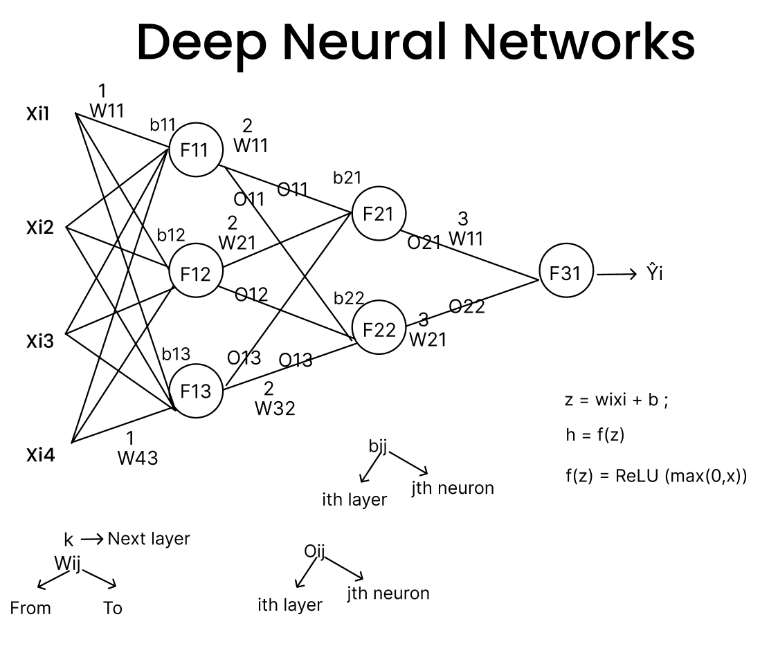
Training is a four-step loop, repeated many thousands of times
1
Forward pass
2
Loss
3
Backward pass
4
Update
Inputs flow layer by layer: z = Wx + b, a = f(z)
One number for how wrong the predictions are
Backprop computes ∂L/∂w for every weight
The optimizer nudges each weight against its gradient
out = model(x)
loss = criterion(out, y)
loss.backward()
optimizer.step()
↻ repeat for every mini-batch; one pass over the data = one epoch
Notation used today
wᵢⱼᵏ: weight from unit i to unit j in layer k
z = Σ wᵢxᵢ + b, the weighted sum (pre-activation)
a = f(z), the activation; ŷ is the final output
L(ŷ, y): the loss; η: the learning rate
Figure: C. P. Bathula, Deep Learning series, Part 5
Notes:
One iteration: take a mini-batch, run it forward to get predictions, compute a single loss number, run backprop to get the gradient of the loss with respect to every weight, and let the optimizer take a small step. One pass through all training data is an epoch. In PyTorch these are four lines: out = model(x); loss = criterion(out, y); loss.backward(); optimizer.step(), with optimizer.zero_grad() first.

Slide 35
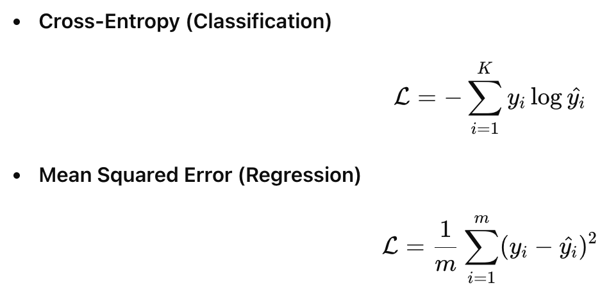
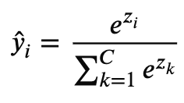
The loss turns "how wrong" into one number
Task (this week's notebook) | Output layer | Loss in PyTorch
Regression (California housing) | Linear(32, 1), no activation | nn.MSELoss()
Binary (heart disease) | Linear(32, 1) + Sigmoid | nn.BCELoss()
Multi-class (MNIST) | Linear(128, 10) logits | nn.CrossEntropyLoss()
Why cross-entropy for classification?
It is the negative log-probability of the correct class: −log ŷ_true
Predict 0.9 for the right class: loss 0.11. Predict 0.01: loss 4.6
Confident mistakes give large gradients, so learning starts fast
With softmax, the gradient is simply ŷ − y
Figure: C. P. Bathula, Deep Learning series, Part 5
Softmax turns K scores into probabilities
Outputs are positive and sum to 1.
Notes:
Pick the loss to match the task and the output layer. Regression: no output activation and mean squared error (the California housing notebook uses nn.MSELoss, with Huber or L1 as alternatives). Binary classification: one sigmoid output and binary cross-entropy (the heart-disease notebook uses nn.Sigmoid and nn.BCELoss). Multi-class: raw logits and nn.CrossEntropyLoss, which applies softmax internally (the MNIST notebook). Cross-entropy punishes confident wrong answers heavily, which gives strong gradients early in training.

Slide 36
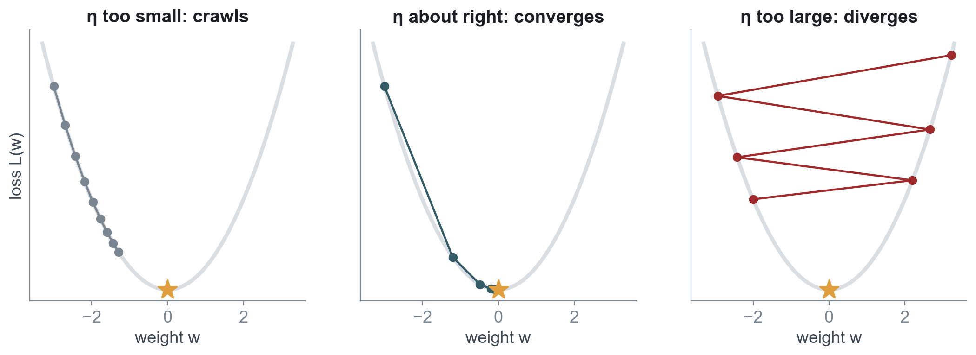
Gradient descent: take small steps downhill
w ← w − η · ∂L/∂w
Gradient = slope
Step size matters
Local view only
∂L/∂w > 0 means increasing w raises the loss, so decrease w.
The gradient gives a direction; η gives the distance.
Each step uses just the slope where you stand.
η = learning rate (step size)
Notes:
The gradient points uphill, in the direction the loss grows fastest, so we step the other way. The learning rate η sets the step size. Too small and training crawls; too large and it overshoots and diverges. This plot is real gradient descent on L(w) = w² with η = 0.05, 0.3 and 1.05. In practice try 1e-3 for Adam and 0.01 to 0.1 for SGD with momentum, then tune; the notebooks expose LEARNING_RATE for this.

Slide 37
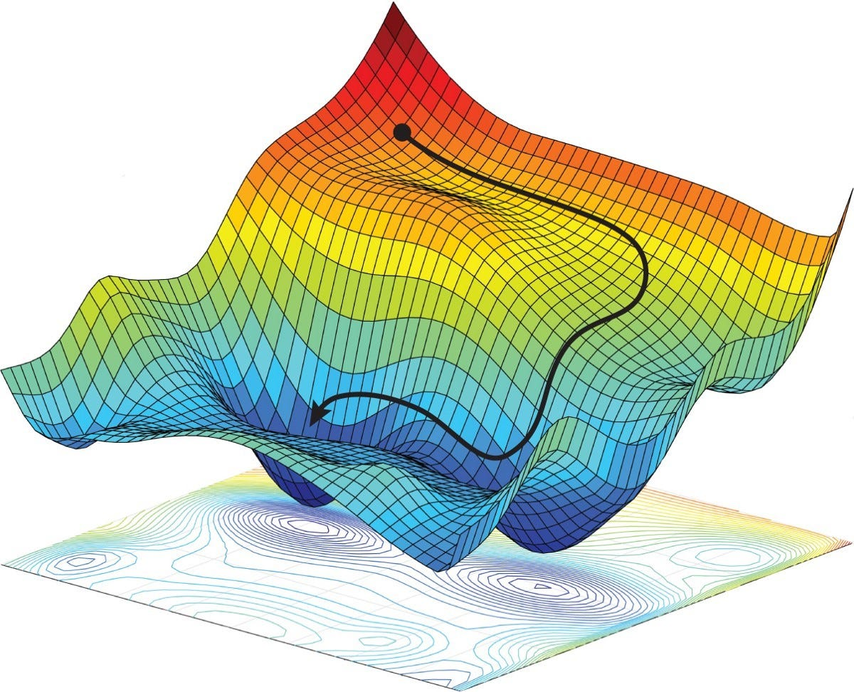

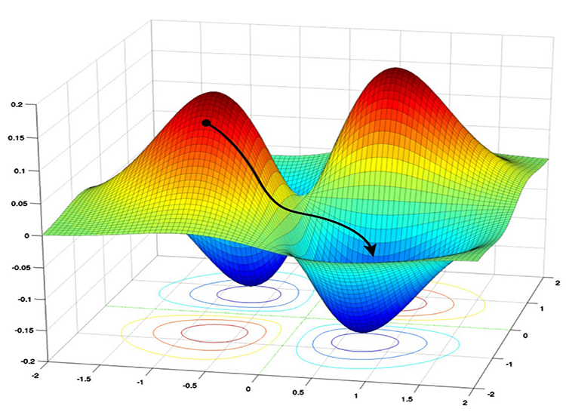


Real loss landscapes are not a simple bowl
Local minima
Valleys that are not the lowest point. Usually fine in big networks.
Saddle points
Downhill one way, uphill another; gradients near zero.
Plateaus
Flat regions where progress slows to a crawl.
Figures: C. P. Bathula, Deep Learning series, Part 9
Good news: the noise in mini-batch gradients helps escape saddles and plateaus, and momentum carries the optimizer across flat regions.
Notes:
A network with millions of weights has a loss surface in millions of dimensions with many minima, saddle points and flat plateaus. Dauphin et al. (2014) argued that in high dimensions most problematic critical points are saddle points rather than bad local minima. In practice many minima found by SGD perform similarly well, and the noise of mini-batches helps escape saddles and sharp minima.

Slide 38
Backpropagation is the chain rule, applied right to left
Forward: compute and cache values →
x, w, b
z = w·x + b
ŷ = ReLU(z)
L = ½(y − ŷ)²
inputs
weighted sum
activation
loss
∂z/∂w = x
∂ŷ/∂z = 1 if z > 0
∂L/∂ŷ = ŷ − y
← Backward: multiply local derivatives
∂L/∂w = ∂L/∂ŷ · ∂ŷ/∂z · ∂z/∂w = (ŷ − y) · 1[z > 0] · x
Local
Reuse
Automatic
Each node knows only its own derivative and the gradient arriving from the right.
Cached forward values make the backward pass cheap: about the cost of a forward pass.
loss.backward() in PyTorch builds and runs this graph for every weight.
Notes:
Forward: compute and cache every intermediate value. Backward: start from the loss and multiply local derivatives going right to left. Each node only needs its own local derivative and the gradient arriving from the right. Because the backward pass reuses cached forward values, computing the gradient for all weights costs about the same as one or two forward passes, which is why backprop scales to billions of weights. PyTorch's autograd does exactly this when you call loss.backward().

Slide 39
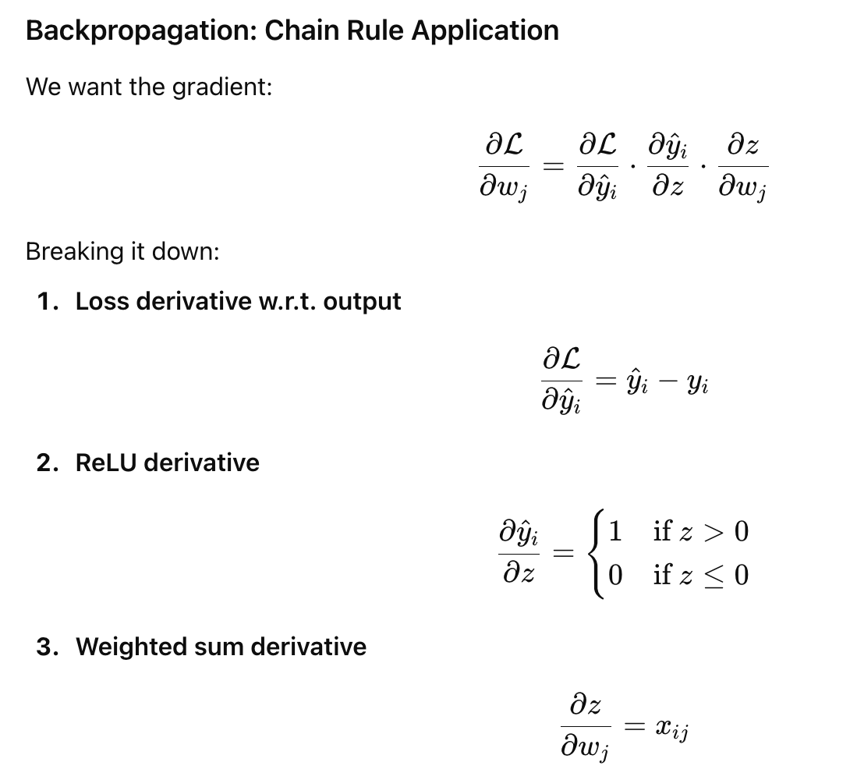
Backprop by hand: one neuron, one update
Step | Computation | Value
Forward | z = w·x + b = 0.5 × 2 + 0.1 | 1.1
 | ŷ = ReLU(z) | 1.1
 | L = ½(y − ŷ)² = ½(2 − 1.1)² | 0.405
Backward | ∂L/∂ŷ = ŷ − y | −0.9
 | ∂ŷ/∂z = 1 (because z > 0) | 1
 | ∂L/∂w = −0.9 × 1 × x (= 2) | −1.8
 | ∂L/∂b = −0.9 × 1 × 1 | −0.9
Update | w ← 0.5 − 0.1 × (−1.8) | 0.68
 | b ← 0.1 − 0.1 × (−0.9) | 0.19
Check | new ŷ = 0.68 × 2 + 0.19; new L = ½(2 − 1.55)² | 1.55; 0.101
Figure: C. P. Bathula, Deep Learning series, Part 5
Loss 0.405 → 0.101 in one step
Start: x = 2, w = 0.5, b = 0.1, target y = 2, η = 0.1
Notes:
Worked example to do on the board. Start with x = 2, w = 0.5, b = 0.1, target y = 2, learning rate 0.1, ReLU activation and squared-error loss. Forward: z = 1.1, prediction 1.1, loss 0.405. Backward: dL/dŷ = -0.9, dŷ/dz = 1 because z > 0, dz/dw = x = 2, so dL/dw = -1.8 and dL/db = -0.9. Update: w becomes 0.68 and b becomes 0.19. Check: the new prediction is 1.55 and the loss falls to about 0.101, a 75% drop in one step.

Slide 40
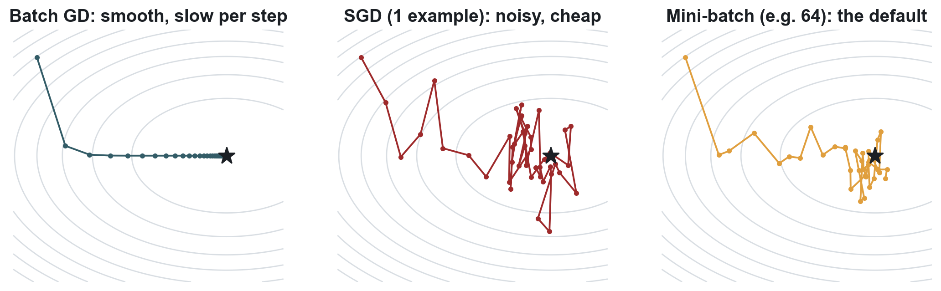
Batch, stochastic and mini-batch gradient descent
 | Batch GD | Stochastic GD | Mini-batch GD
Examples per update | All N | 1 | B (typically 32–512)
Updates per epoch (MNIST, N = 60,000) | 1 | 60,000 | 938 with B = 64
Gradient noise | None | High | Moderate: helps escape saddles
Hardware use | Memory-bound on large data | Poor GPU utilisation | Fills the GPU: the default
Notes:
Batch gradient descent uses all N examples for every update: accurate but slow, and impossible when data does not fit in memory. Stochastic gradient descent (Robbins and Monro, 1951) uses one example: cheap and noisy. Mini-batch is the practical default, typically 32 to 512 examples: it uses GPU parallelism well and its moderate noise helps generalization. In PyTorch the optimizer called SGD is really mini-batch SGD; the batch size is set in the DataLoader.

Slide 41
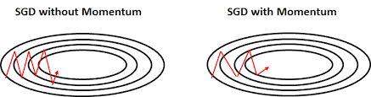
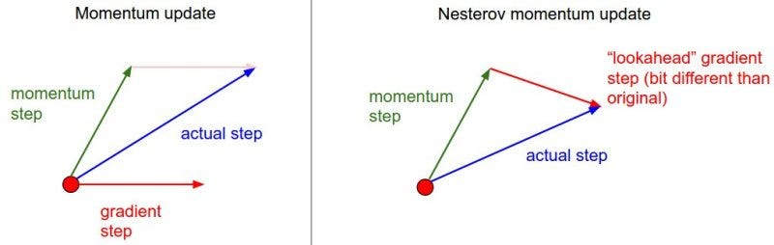
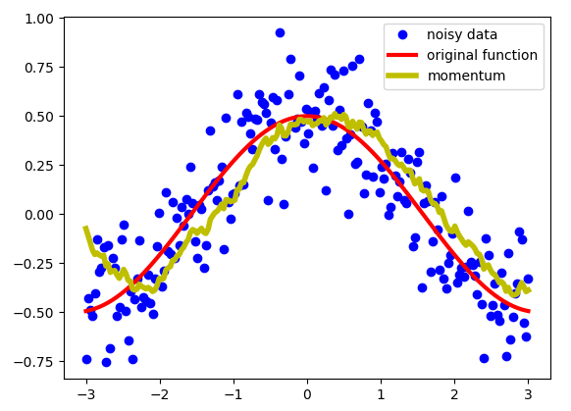
Momentum: remember where you were going
v ← β v + ∇L(w)
w ← w − η v
β ≈ 0.9: velocity is a running average of about the last 10 gradients.
Nesterov (1983)
Look ahead first: take the gradient at w − ηβv, then correct. Less overshoot.
Consistent directions accelerate; oscillating directions cancel out.
Figures: C. P. Bathula, Deep Learning series, Part 9
PyTorch: optim.SGD(model.parameters(), lr=0.01, momentum=0.9, nesterov=True). This is the swap suggested in the MNIST notebook.
Notes:
Plain SGD zig-zags across narrow valleys. Momentum (Polyak's heavy-ball method, 1964) keeps an exponentially weighted moving average of past gradients, so steps that agree add up and steps that flip sign cancel. With β = 0.9 the velocity averages roughly the last 10 gradients. Nesterov's accelerated gradient (1983) evaluates the gradient at the look-ahead point, which corrects the step before it overshoots. In PyTorch: optim.SGD(params, lr=0.01, momentum=0.9, nesterov=True).

Slide 42
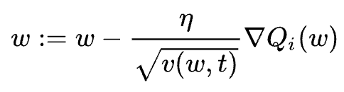
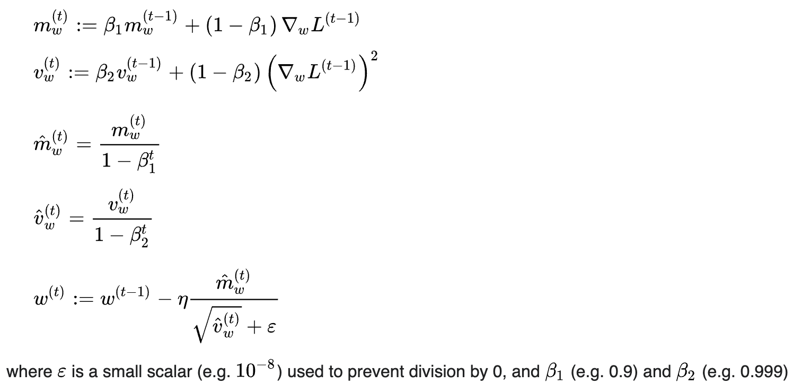
Adaptive optimizers: a learning rate for every weight
Year | Optimizer | Idea in one line
1951 | SGD | Step against the gradient of a random sample
1964 | Momentum | Average past gradients to build velocity
1983 | Nesterov | Take the gradient at the look-ahead point
2011 | AdaGrad | Divide by accumulated squared gradients
2012 | RMSprop | Use a moving average instead, so steps don't vanish
2014 | Adam | Momentum + RMSprop + bias correction
2017 | AdamW | Adam with weight decay decoupled from the step
Figures: C. P. Bathula, Deep Learning series, Part 9
Which to use: start with Adam or AdamW (lr = 1e-3). For CNNs trained long, SGD + momentum with a schedule often generalizes slightly better.
Notes:
AdaGrad (Duchi, Hazan and Singer, 2011) divides each weight's step by the root of its accumulated squared gradients, so rarely updated weights take bigger steps; but the accumulator only grows, so learning eventually stalls. RMSprop (Hinton, Coursera lecture 6e, 2012) replaces the sum with a moving average. Adam (Kingma and Ba, 2014) combines momentum with RMSprop and corrects the bias of the averages in the first steps; defaults β1 = 0.9, β2 = 0.999, lr = 1e-3. AdamW (Loshchilov and Hutter) decouples weight decay from the adaptive step and is standard for Transformers. All three notebooks use Adam.

Slide 43
Activations, initialization, normalization, regularization
PART 6 · MAKING DEEP NETWORKS TRAINABLE
The tricks that turned 1986's backprop into 2012's 8-layer and 2015's 152-layer networks
Notes:
These are the knobs marked with arrows in the notebooks: swap the activation, remove BatchNorm, change dropout, switch the optimizer. Related reading: Deep Learning series Parts 6, 7 and 8.

Slide 44
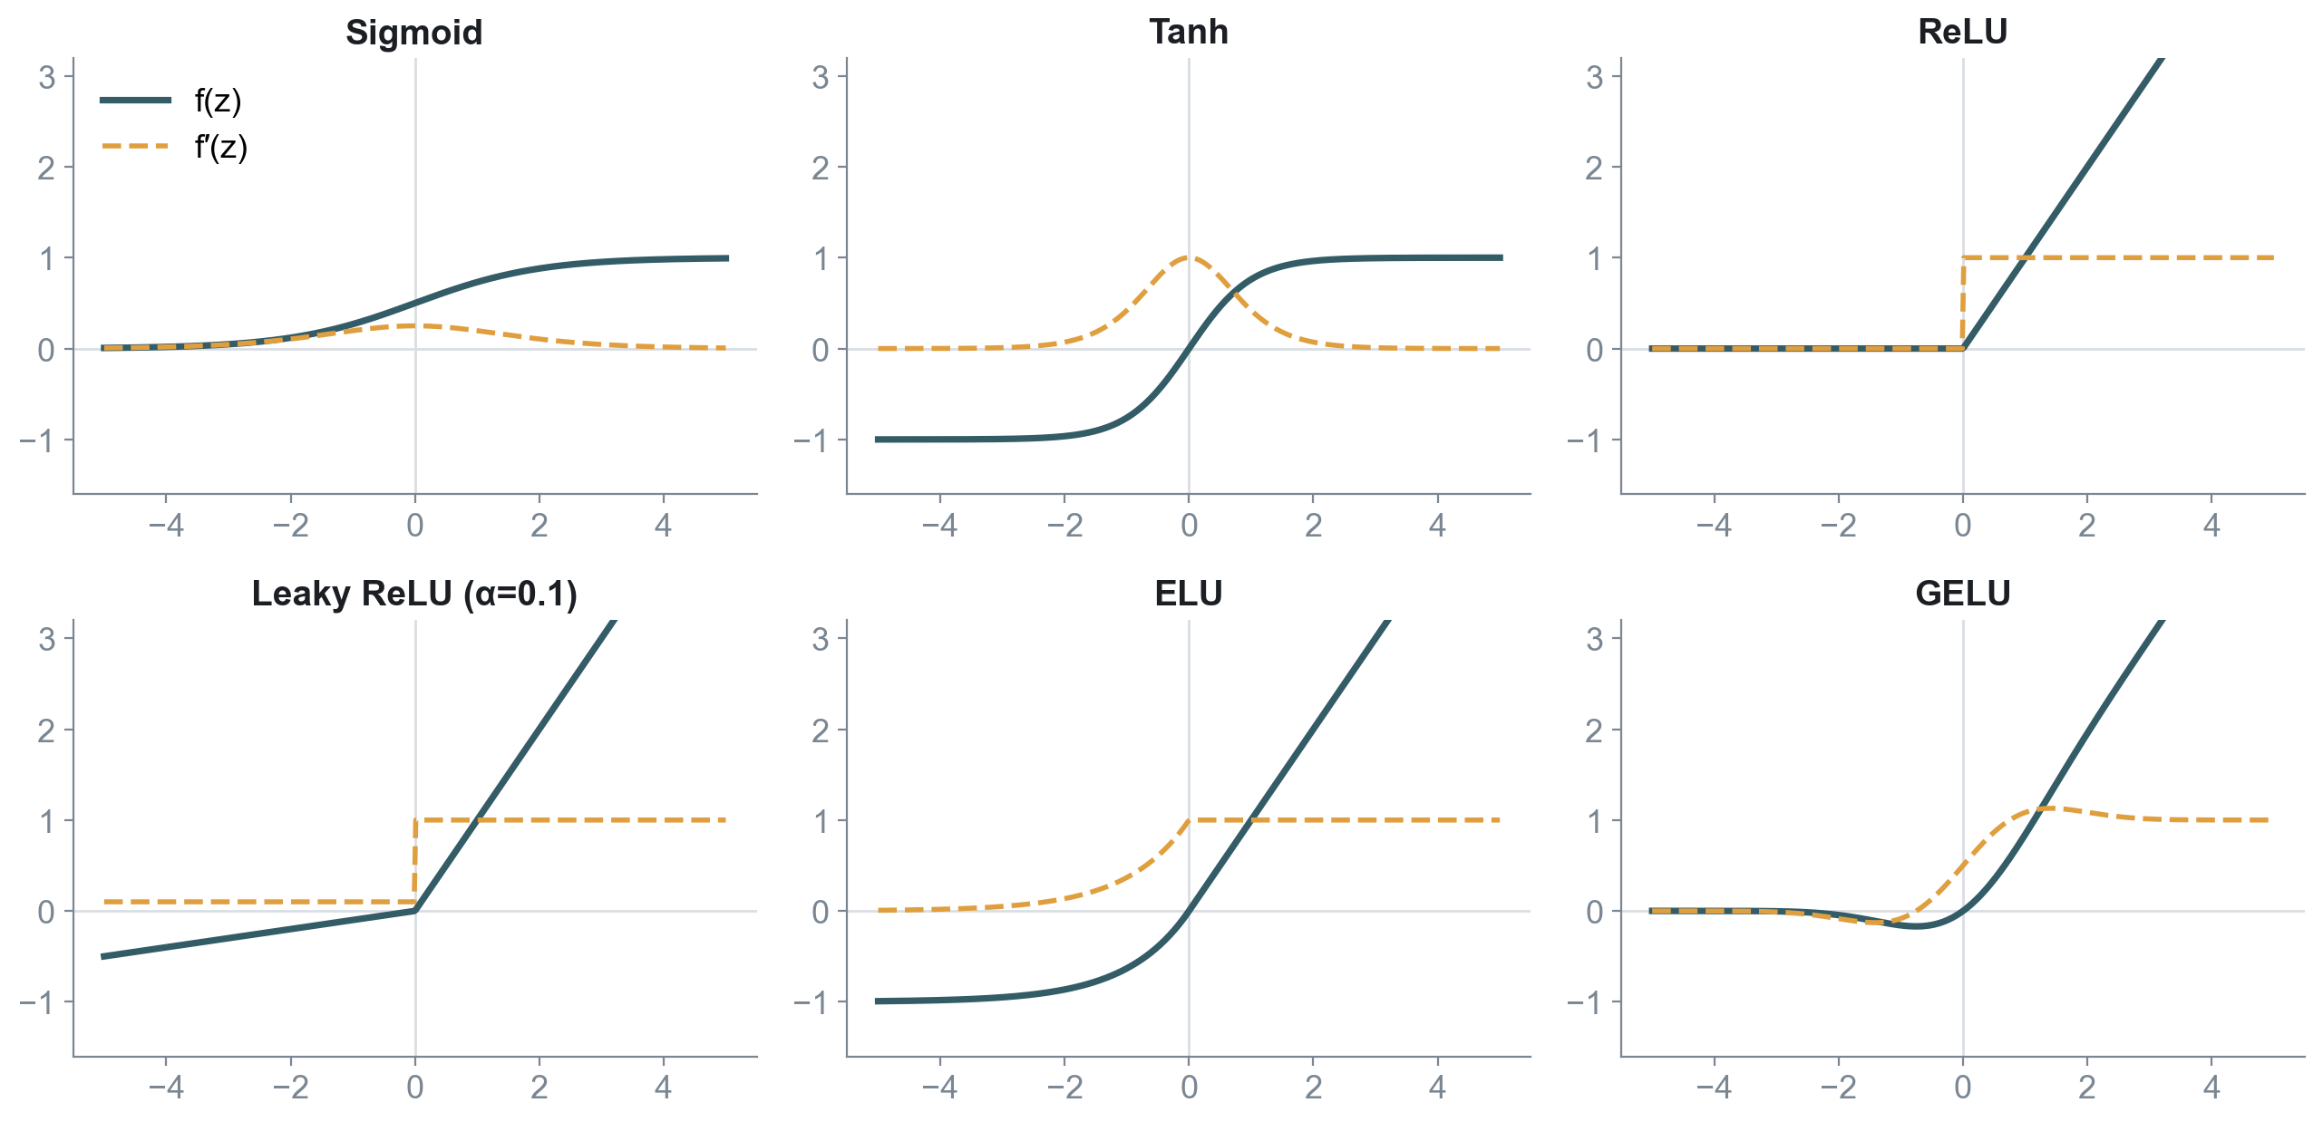
Activation functions: the non-linearity is the point
Read the dashed line
Backprop multiplies these slopes layer after layer
Sigmoid: slope ≤ 0.25, near 0 at the tails
Tanh: zero-centred, but still saturates
ReLU: slope 1 for z > 0, cheap to compute
GELU: a smooth ReLU used in Transformers
No activation, no depth: W₂(W₁x) = (W₂W₁)x. Stacked linear layers collapse into one linear model.
Notes:
Without a non-linear activation, stacking layers is pointless: W2(W1x) = (W2W1)x, a single linear map. The activation lets each layer bend the space. Solid lines are the functions, dashed lines their derivatives, which is what backprop multiplies. Sigmoid and tanh saturate: their slopes go to zero for large |z|. ReLU's slope is exactly 1 for positive inputs. Leaky ReLU (Maas et al. 2013) and ELU (Clevert et al. 2015) keep a small slope for negatives; GELU (Hendrycks and Gimpel 2016) is the smooth default in Transformers like BERT and GPT.

Slide 45
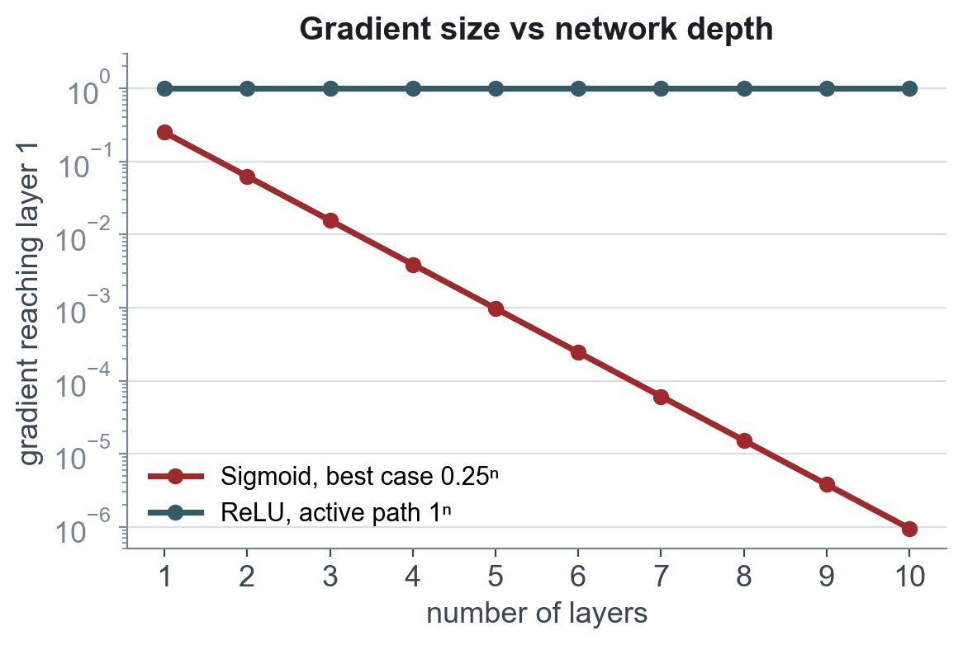
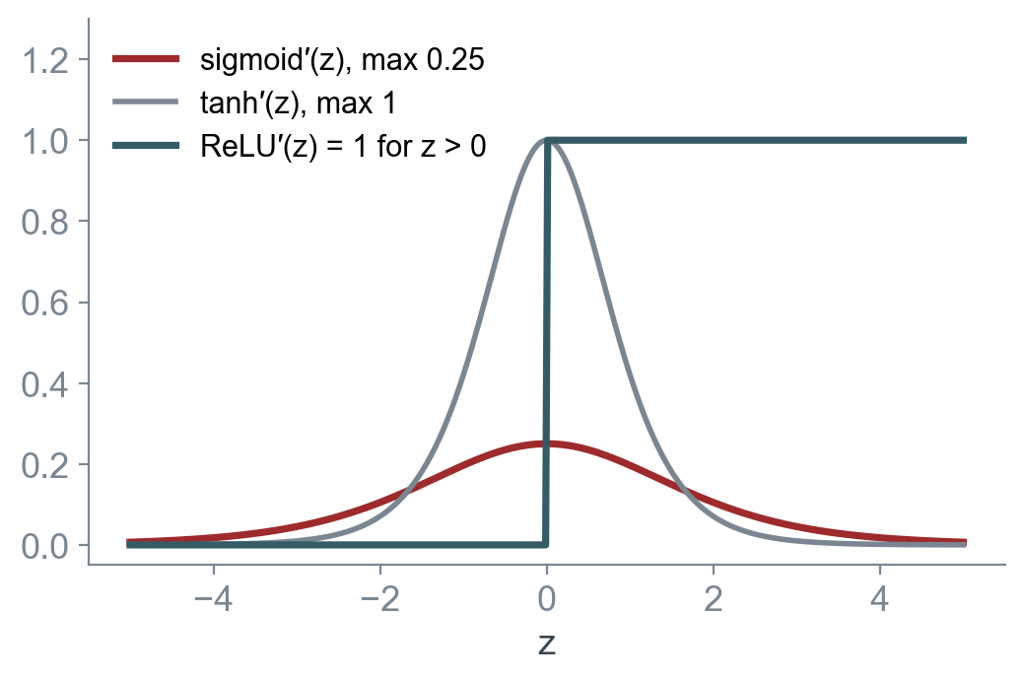
The vanishing gradient, in one chart
0.25¹⁰ ≈ 10⁻⁶
1
> 1 per layer
Sigmoid, 10 layers, best case
ReLU, any depth, active units
Exploding gradients: clip them
Notes:
This is why deep sigmoid networks did not train in the 1990s. The gradient reaching layer 1 contains a product of one activation slope per layer. With sigmoid the best case is 0.25 per layer, so after 10 layers it is about one millionth. ReLU passes gradients through unchanged for active units. The opposite problem, exploding gradients, happens when the per-layer factor exceeds 1; gradient clipping and careful initialization address it.

Slide 46
Choosing an activation function
Activation | Formula | Range | Strength | Watch out for | Typical use
Sigmoid | 1 / (1 + e⁻ᶻ) | (0, 1) | Reads as a probability | Saturates; slope ≤ 0.25; not zero-centred | Binary output layer
Tanh | (eᶻ − e⁻ᶻ)/(eᶻ + e⁻ᶻ) | (−1, 1) | Zero-centred | Still saturates at the tails | RNN / LSTM gates
ReLU | max(0, z) | [0, ∞) | Fast; slope 1 when active | "Dying" units stuck at 0 | Default hidden layer
Leaky ReLU | max(αz, z), α ≈ 0.01–0.1 | (−∞, ∞) | No dead units | Extra hyperparameter α | Hidden layers
ELU | z, or α(eᶻ − 1) if z < 0 | (−α, ∞) | Smooth, mean near 0 | Slower (uses exp) | Hidden layers
GELU | z · Φ(z) | ≈ (−0.17, ∞) | Smooth ReLU | Slightly more compute | Transformers (BERT, GPT)
Softmax | eᶻⁱ / Σₖ eᶻᵏ | (0, 1), sums to 1 | Class probabilities | Pass raw logits to CrossEntropyLoss | Multi-class output
Rule of thumb: ReLU inside, and the output activation set by the task: none for regression, sigmoid for binary, softmax for multi-class.
Notes:
Default to ReLU in hidden layers of MLPs and CNNs, and GELU in Transformers. If many ReLU units die (always output zero after a big negative update), try Leaky ReLU or lower the learning rate. Use sigmoid only at the output for binary classification, softmax at the output for multi-class, and no activation at the output for regression. The notebooks let you swap nn.ReLU for nn.Tanh, nn.LeakyReLU(0.1), nn.ELU or nn.GELU.

Slide 47
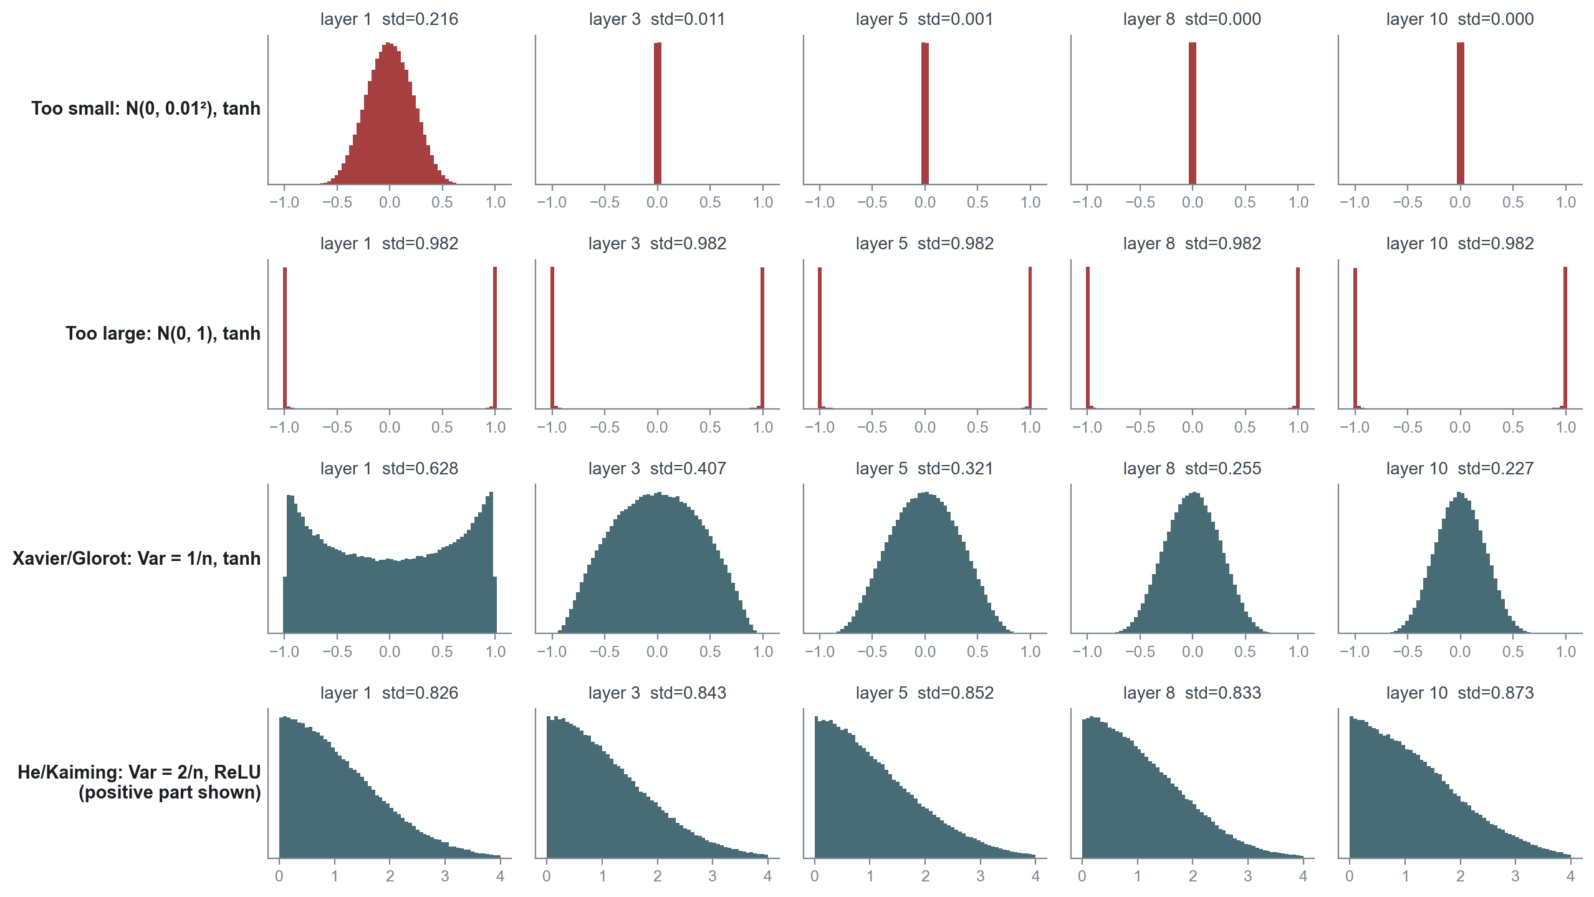
Weight initialization: start every layer in the right range
All zeros
Every unit gets the same gradient and stays identical: symmetry is never broken.
Xavier / Glorot (2010)
Var(W) = 2 / (fan-in + fan-out), which is 1/n for square layers. For tanh and sigmoid.
He / Kaiming (2015)
Var(W) = 2 / fan-in. For ReLU, which zeroes half its inputs.
Simulated: 10 layers × 512 units, 1,000 random inputs (NumPy).
nn.init.kaiming_normal_(w)
Notes:
This figure is a real NumPy simulation: 1,000 inputs through 10 layers of 512 units, histogram of activations at layers 1, 3, 5, 8 and 10. Too-small weights shrink the signal until every activation is zero, so gradients vanish. Too-large weights push tanh into saturation at plus or minus one, so gradients also vanish. Xavier/Glorot (2010) sets the variance so signals keep roughly the same scale through tanh layers; He/Kaiming (2015) doubles it to compensate for ReLU zeroing half its inputs. Initializing all weights to zero is worse still: every unit in a layer gets the same gradient and they never differ, the symmetry problem.

Slide 48
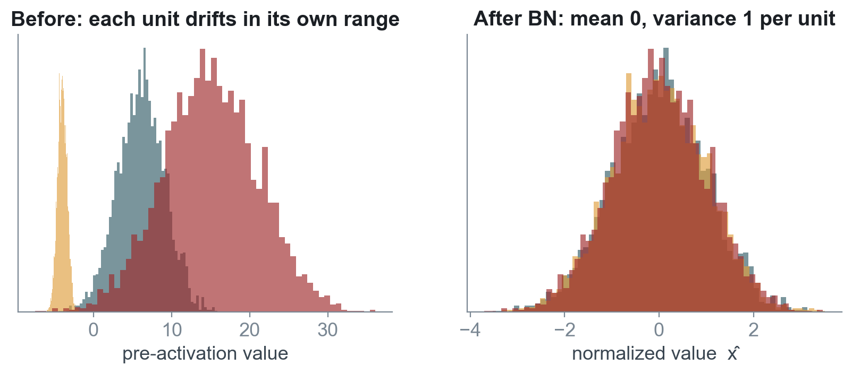
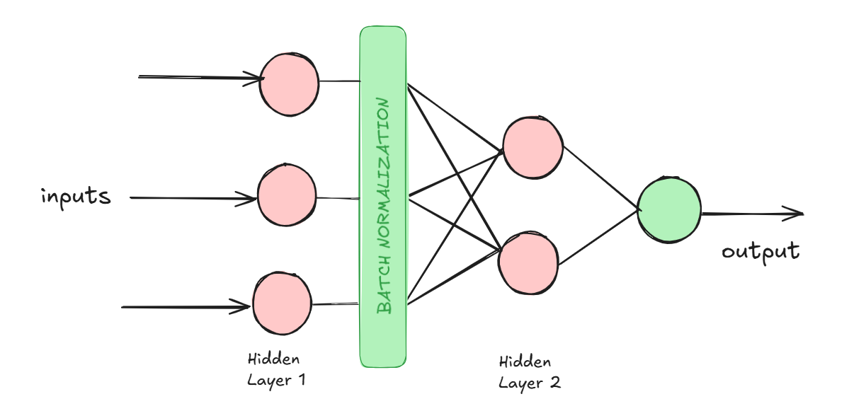



Batch normalization: keep each layer's inputs steady
μ = mean over the mini-batch
σ² = variance over the mini-batch
x̂ = (x − μ) / √(σ² + ε)
y = γ x̂ + β
γ and β are learned, so the layer can undo the normalization if that helps.
Higher learning rates
Less init sensitivity
Training is more stable, so steps can be larger.
Normalized inputs forgive a rough start.
Mild regularizer
Train vs eval
Batch statistics add noise, like light dropout.
Uses running averages at inference: model.eval().
Figure: C. P. Bathula, Deep Learning series, Part 8
Notes:
Ioffe and Szegedy (2015) normalize each unit's pre-activations over the mini-batch to mean 0 and variance 1, then let the network re-scale with learned γ and shift with β, so it can undo the normalization if that helps. They motivated it as reducing internal covariate shift; later work (Santurkar et al. 2018) suggests the main benefit is a smoother loss landscape. It allows higher learning rates, makes training less sensitive to initialization and adds a little regularization. At inference it uses running averages, so call model.eval(). Layer normalization (Ba, Kiros and Hinton 2016) normalizes across features instead and is used in Transformers. In the notebooks, remove the BatchNorm1d lines to see the difference.

Slide 49





Overfitting: when the network memorizes
L2 / weight decay
L1
Penalize large weights
Push weights to exactly zero
Dropout
Early stopping
Randomly silence units in training
Keep the best validation epoch
Data augmentation
Batch norm
More varied examples (Week 1)
Regularizes as a side effect
Illustrative curves.
Early stopping: track validation loss every epoch, save the best weights, stop after it fails to improve for a few epochs ("patience").
Notes:
Deep networks have far more parameters than examples (the Week 1 MNIST MLP had 109,386 weights for 5,000 images), so they can memorize noise. The tell-tale sign is training loss still falling while validation loss rises. The figure is illustrative. Regularization is anything that trades a little training accuracy for better generalization; the next slides cover the main tools, and the notebooks let you vary dropout and BatchNorm and compare curves.

Slide 50

L1 and L2 regularization put a price on large weights
L2 (ridge / weight decay)
loss + λ Σ w²
Shrinks all weights smoothly toward 0.
L1 (lasso)
loss + λ Σ |w|
Drives some weights exactly to 0: built-in feature selection.
 | L1 | L2
Effect on weights | Sparse: many exactly 0 | Small, rarely exactly 0
In PyTorch | Add λ·Σ|w| to the loss yourself | weight_decay=1e-4 in the optimizer (AdamW for Adam)
Notes:
Add a penalty to the loss. L2 (ridge, weight decay) adds lambda times the sum of squared weights; its gradient shrinks every weight in proportion to its size, so weights stay small but rarely become exactly zero. L1 (lasso) adds lambda times the sum of absolute weights; the constraint region has corners on the axes, so the optimum often lands on one, setting some weights exactly to zero. Geometrically, the solution is where the loss contours first touch the constraint region. In PyTorch, weight_decay in the optimizer is L2; for Adam prefer AdamW, which applies it correctly.

Slide 51


Dropout: train a crowd of thinned networks
Breaks co-adaptation: no unit can rely on a specific partner
Acts like averaging an ensemble of thinned networks
Figures after Srivastava et al., JMLR 2014, via C. P. Bathula, Deep Learning series, Part 7
0.2–0.5
1 / (1 − p)
model.eval()
typical drop rate in hidden layers (notebooks: 0.3 and 0.2)
inverted dropout scales kept units during training
turns dropout off for validation and testing
Notes:
Srivastava, Hinton, Krizhevsky, Sutskever and Salakhutdinov, JMLR 2014 (first described by Hinton et al. in 2012). During training each unit is kept with probability p and dropped otherwise, so the network cannot rely on any single unit; co-adaptations break up and features become more robust. Each mini-batch trains a different thinned network, and the full network at test time behaves like an average of exponentially many of them. Typical drop rates: 0.2 to 0.5 for hidden layers. PyTorch uses inverted dropout: it scales kept activations by 1/(1−p) during training so nothing changes at test time, and model.eval() turns dropout off. The notebooks use nn.Dropout(0.3) and 0.2.

Slide 52
Reading the training curves: symptoms and fixes
What you see | Likely cause | Try
Loss becomes NaN or explodes | Learning rate too high; exploding gradients | Lower lr by 10×; gradient clipping; check input scaling
Loss flat from the start | Learning rate too low; dead ReLUs; bad init | Raise lr; He init; Leaky ReLU; add BatchNorm
Training ↓, validation ↑ | Overfitting | Dropout, weight decay, augmentation, early stopping, smaller model
Training and validation both high | Underfitting | Bigger model, train longer, higher lr, less regularization
Validation noisy, jumping around | Batch too small or lr too high | Larger batch; lower lr; lr schedule
Good in training, poor after model.eval() | BatchNorm or dropout mode issue | Call model.train() / model.eval() correctly; batch size > 1 for BN
Very slow progress | Unscaled inputs; plain SGD | Standardize features; Adam; BatchNorm
Habit: change one knob at a time, keep the random seed fixed, and write down train and validation numbers for every run.
Notes:
Use this as a checklist while running the notebooks. Always look at both training and validation curves. Change one knob at a time and record what happened.

Slide 53

Putting it together: the MNIST MLP from this week's notebook
model = nn.Sequential(
nn.Flatten(), # 28x28 -> 784
nn.Linear(784, 512), # z = Wx + b
nn.BatchNorm1d(512), # batch norm
nn.ReLU(), # activation
nn.Dropout(0.3), # regularization
nn.Linear(512, 256), nn.BatchNorm1d(256),
nn.ReLU(), nn.Dropout(0.3),
nn.Linear(256, 128), nn.ReLU(),
nn.Linear(128, 10)) # logits, no softmax
criterion = nn.CrossEntropyLoss() # softmax + log loss
optimizer = optim.Adam(model.parameters(), lr=1e-3)
for epoch in range(EPOCHS):
model.train() # dropout and BN on
for imgs, lbls in train_loader: # mini-batches
optimizer.zero_grad()
loss = criterion(model(imgs), lbls) # forward
loss.backward() # backprop
optimizer.step() # update
model.eval() # dropout off, BN stats
Architecture
784 → 512 → 256 → 128 → 10: Week 1's MLP, deeper and wider
Trainability
BatchNorm1d and ReLU keep gradients healthy
Regularization
Dropout(0.3) in the two widest layers
Learning
Cross-entropy loss, backprop, Adam on mini-batches
Notes:
This is the model from Multi_Class_Classification.ipynb, lightly simplified. Every line maps to something from today. There is no softmax at the end because CrossEntropyLoss applies it. Try the arrows in the notebook: swap the activation, remove BatchNorm, change dropout, switch Adam for SGD with momentum, and plot the train and test curves for each.

Slide 54


This week's work
Binary classification
Multi-class classification
Regression
Heart disease (tabular)
MNIST digits (images)
California housing (tabular)
Model 64 → 32 → 1 + Sigmoid, BCELoss, Adam
Model 784 → 512 → 256 → 128 → 10, CrossEntropyLoss
Model 128 → 64 → 32 → 1, MSELoss
Experiment Compare against a boosted tree: does the MLP win on tabular data?
Experiment Swap ReLU for Tanh or GELU; remove BatchNorm; try SGD + momentum.
Experiment Try HuberLoss and L1Loss; vary dropout; watch RMSE.
Deliverable: for each notebook, one baseline run plus at least two single-knob experiments, with training and test curves and a short explanation.
Notes:
Three notebooks, same skeleton, different heads. Each has arrows marking knobs to change. Run the baseline, then change one knob at a time, and write up what moved and why using today's vocabulary. The APA 7 student paper guide in the folder is the formatting reference for the written reflection.

Slide 55
Four ideas to take away
1
Deep learning wins on raw, high-dimensional data
because it learns its own features instead of relying on hand-made ones.
2
The neuron barely changed since 1943
What changed: a smooth activation, backprop (1986), then data and GPUs (2012).
3
Training = forward, loss, backprop, update
Optimizers only change how the update step is taken.
4
Depth became trainable
thanks to ReLU, good initialization, batch norm and regularization.
Notes:
Close by connecting the threads: the story and the mechanics are one story. Every historical failure (no learning, XOR, vanishing gradients) has a modern fix you will toggle in the notebooks.

Slide 56
Further reading
Deep Learning series, C. P. Bathula (Towards AI)
Primary sources
1
Part 1: A Brief History of Deep Learning Evolution
McCulloch & Pitts (1943), Bull. Math. Biophysics
Rosenblatt (1958), Psychological Review
Rumelhart, Hinton & Williams (1986), Nature
Hochreiter & Schmidhuber (1997), Neural Computation
LeCun et al. (1998), Proc. IEEE (LeNet-5)
Krizhevsky, Sutskever & Hinton (2012), NeurIPS
Glorot & Bengio (2010); He et al. (2015)
Srivastava et al. (2014), JMLR (dropout)
Ioffe & Szegedy (2015), ICML (batch norm)
Kingma & Ba (2015), ICLR (Adam)
Goodfellow, Bengio & Courville, Deep Learning (2016)
2
Part 2: Biological Neural Network vs Artificial Neural Network
3
Part 3: Perceptron vs Logistic Regression
4
Part 4: Multi-Layered Perceptron (MLP)
5
Part 5: How to Train Your Neural Networks
6
Part 6: Activation Functions in Neural Networks
7
Part 7: Dropouts & Regularization
8
Part 8: Initialization & Normalization
9
Part 9: Optimizers Are What You Need
Notes:
The nine-part Deep Learning series on Towards AI follows the same sequence as today's lecture; each part goes deeper with derivations and figures. Primary sources are listed for students who want them.

Slide 57
Image credits
Wikimedia Commons
Walter Pitts, 1954: Francis Bello, public domain
Alan Turing: Elliott & Fry, public domain
Frank Rosenblatt: unknown author, CC BY-SA 4.0
Mark I Perceptron manual figure: J. C. Hay & A. E. Murray, public domain
Bernard Widrow with ADALINE: Stanford Today (1963), public domain
Marvin Minsky: Sethwoodworth, CC BY 3.0
Seymour Papert: Matematicamente.it, CC BY-SA 3.0
Paul Werbos; David Rumelhart: Rolf Kickuth, CC BY-SA 4.0
John Hopfield: Jay Dixit, CC BY-SA 4.0
Geoffrey Hinton: Cmichel67, CC BY-SA 4.0
Yann LeCun: Jérémy Barande, CC BY-SA 2.0
Yoshua Bengio: Xuthoria, CC BY-SA 4.0
Jürgen Schmidhuber: ITU/R.Farrell, CC BY 2.0
Sepp Hochreiter: C.Stadler/Bwag, CC BY-SA 4.0
Fei-Fei Li: ITU Pictures, CC BY 2.0
Andrew Ng: TechCrunch, CC BY 2.0
Demis Hassabis: John Sears, CC BY-SA 4.0
AlexNet, LeNet-5 diagrams: Zhang, Lipton, Li & Smola, Dive into Deep Learning, CC BY-SA 4.0
Other figures: C. P. Bathula, Deep Learning series (Towards AI) and AA-5750 course decks. Simulated and illustrative plots were generated for this lecture with NumPy and matplotlib.
Notes:
Wikimedia Commons images are used under the licences shown; CC BY-SA images remain under CC BY-SA. Course diagrams come from the instructor's Deep Learning series and earlier AA-5750 decks; plots marked simulated or illustrative were generated for this lecture.

